Slide 1
Probabilistic Graphical Models
Random Variables and their Distributions

Slide 2
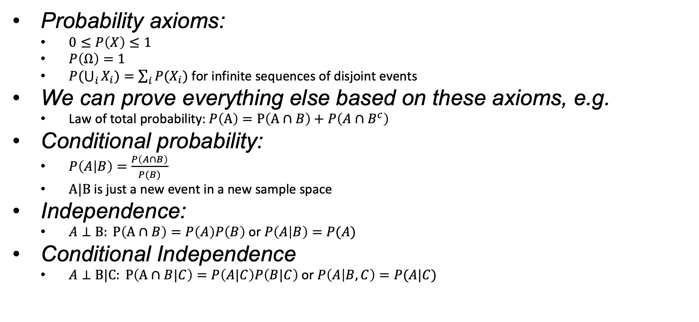
Recap
Probability axioms:
  $0≤P\left(X\right)≤1$
  $P\left(Ω\right)=1$
  $P(\bigcup_{i}{X_{i}})=\sum_{i}{{P(X}_{i})}$ for infinite sequences of disjoint events
We can prove everything else based on these axioms, e.g.
  Law of total probability:$P\left(A\right)=P\left(A∩B\right)+P\left(A∩B^{c}\right)$
Conditional probability:
  $P\left(A | B\right)=\frac{P\left(A∩B\right)}{P(B)}$
  $Α|Β$is just a new event in a new sample space
Independence:
  $A⊥B: P\left(A∩B\right)=P\left(A\right)P\left(B\right)$ or $P\left(A | B\right)=P(A)$
Conditional Independence
  $A⊥B|C: P\left(A∩B|C\right)=P\left(A|C\right)P\left(B|C\right)$ or $P\left(A | B,C\right)=P(A|C)$

Slide 3

Conditional Independence $vs$ Independence
You roll two dice
A: First die gets a 1
B: Second die gets a 1
C: Sum of the two dice is 5
$$P\left(A∩B\right)=$$
$$P\left(A\right)=$$
$$P\left(B\right)=$$
Given C:
$$P\left(A∩B|C\right)=$$
$$P\left(A|C\right)=$$
$$P\left(B|C\right)=$$

Slide 4
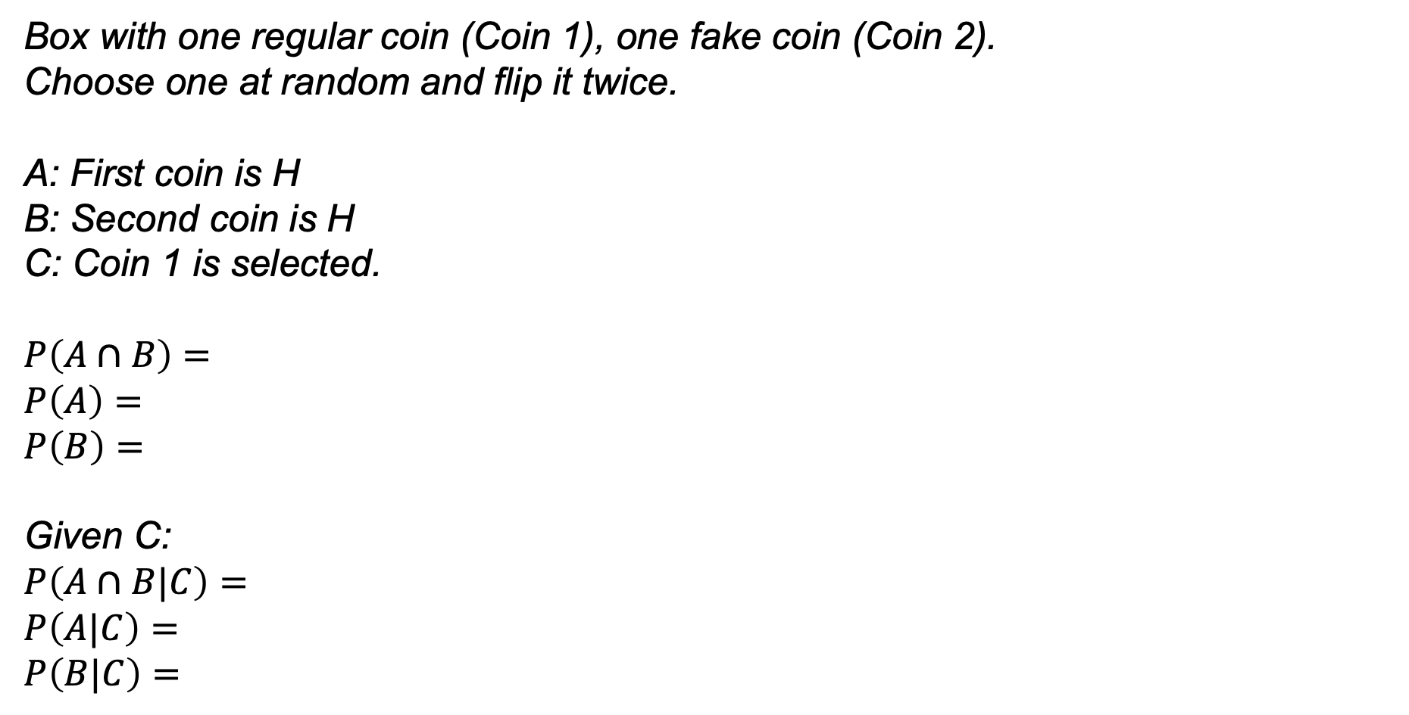
Conditional Independence $vs$ Independence
Box with one regular coin (Coin 1), one fake coin (Coin 2).
Choose one at random and flip it twice.
A: First coin is H
B: Second coin is H
C: Coin 1 is selected.
$$P\left(A∩B\right)=$$
$$P\left(A\right)=$$
$$P\left(B\right)=$$
Given C:
$$P\left(A∩B|C\right)=$$
$$P\left(A|C\right)=$$
$$P\left(B|C\right)=$$

Slide 5
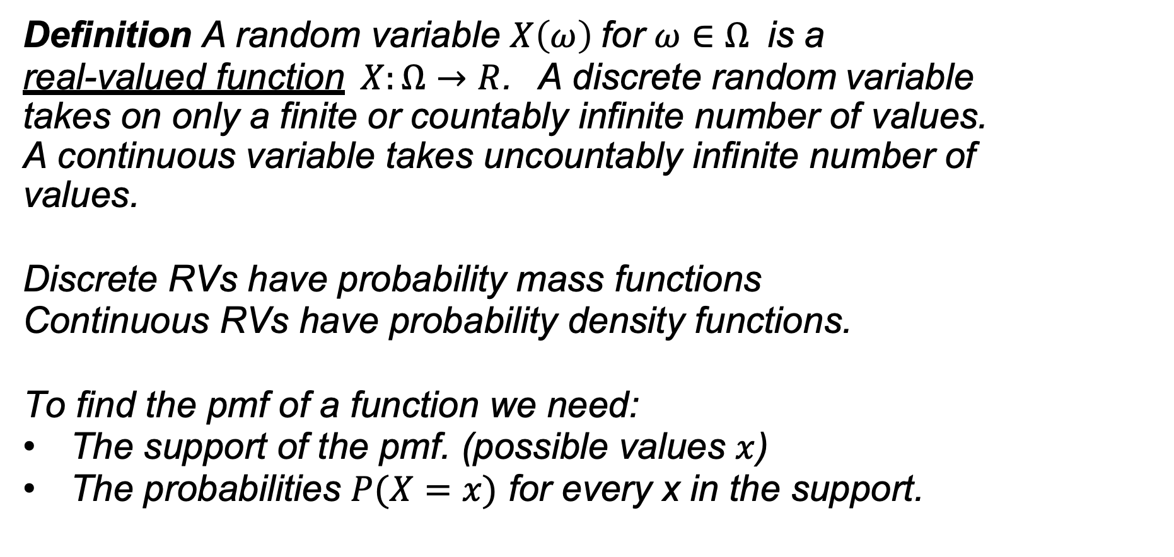
Random Variables
Definition A random variable $X\left(ω\right)$for $ω∈Ω$ is a
real-valued function$X:Ω→R$. A discrete random variable takes on only a finite or countably infinite number of values. A continuous variable takes uncountably infinite number of values.
Discrete RVs have probability mass functions
Continuous RVs have probability density functions.
To find the pmf of a function we need:
The support of the pmf. (possible values $x$)
The probabilities $P(X=x)$ for every x in the support.

Slide 6


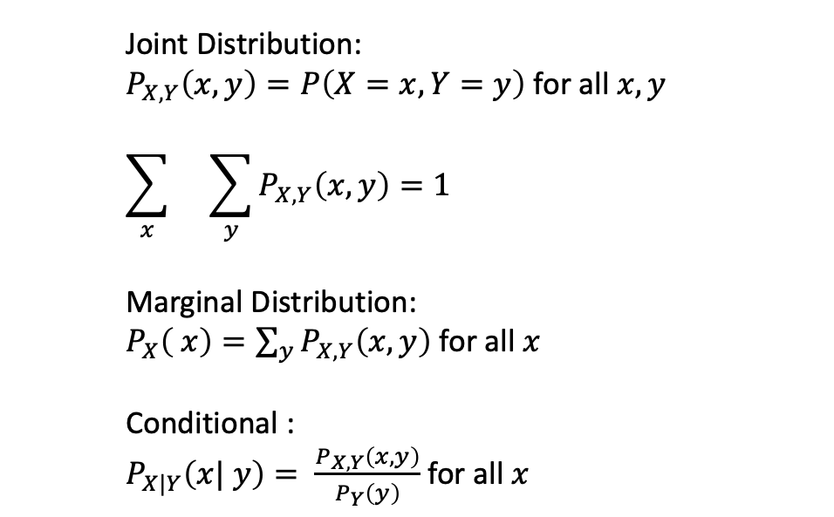
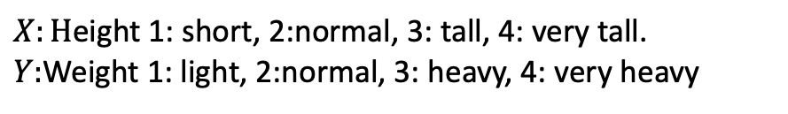
Joint Distributions
$$x$$
Joint Distribution:
$P_{X, Y}\left(x, y\right)=P\left(X=x, Y=y\right)$ for all $x, y$
$$\sum_{x}{}\sum_{y}{P_{X, Y}\left(x, y\right)}=1$$
Marginal Distribution:
$P_{X}\left( x\right)=\sum_{y}{P_{X, Y}\left(x, y\right)}$ for all $x$
Conditional :
$P_{X|Y}\left(x| y\right)= \frac{P_{X, Y}\left(x, y\right)}{P_{Y}\left(y\right)}$ for all $x$
 | 1 | 2 | 3 | 4
4 | 1/20 | 2/20 | 2/20 | 0
3 | 2/20 | 4/20 | 1/20 | 2/20
2 | 0/20 | 2/20 | 1/20 | 0
1 | 0/20 | 1/20 | 2/20 | 0
$$y$$
$X:H$eight 1: short, 2:normal, 3: tall, 4: very tall.
$Y:$Weight 1: light, 2:normal, 3: heavy, 4: very heavy

Slide 7
Joint Distributions
$$x$$
Joint Distribution:
$P_{X, Y}\left(x, y\right)=P\left(X=x, Y=y\right)$ for all $x, y$
$$\sum_{x}{}\sum_{y}{P_{X, Y}\left(x, y\right)}=1$$
Marginal Distribution:
$P_{X}\left( x\right)=\sum_{y}{P_{X, Y}\left(x, y\right)}$ for all $x$
Conditional :
$P_{X|Y}\left(x| y\right)= \frac{P_{X, Y}\left(x, y\right)}{P_{Y}\left(y\right)}$ for all $x$
 | 1 | 2 | 3 | 4
4 | 1/20 | 2/20 | 2/20 | 0 | 5/20
3 | 2/20 | 4/20 | 1/20 | 2/20 | 9/20
2 | 0/20 | 2/20 | 1/20 | 0 | 3/20
1 | 0/20 | 1/20 | 2/20 | 0 | 3/20
 | 3/20 | 9/20 | 6/20 | 2/20
$$y$$
$X:H$eight 1: short, 2:normal, 3: tall, 4: very tall.
$Y:$Weight 1: light, 2:normal, 3: heavy, 4: very heavy

Slide 8


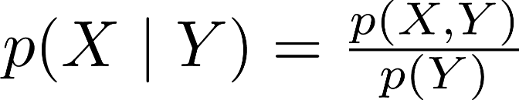
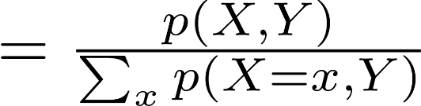



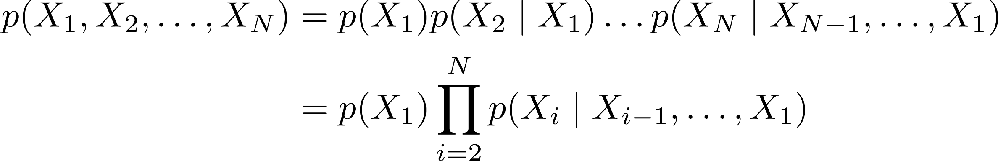
Random Variables
Given two RVs
and the conditional distribution is:
Multiply both sides by
to obtain the probability chain rule:
For RVs
:
Chain rule valid for any ordering

Slide 9
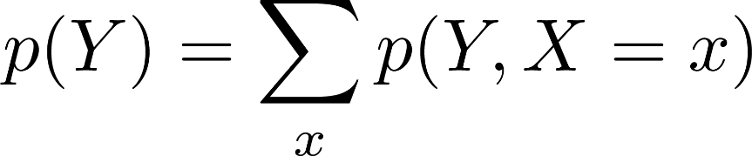
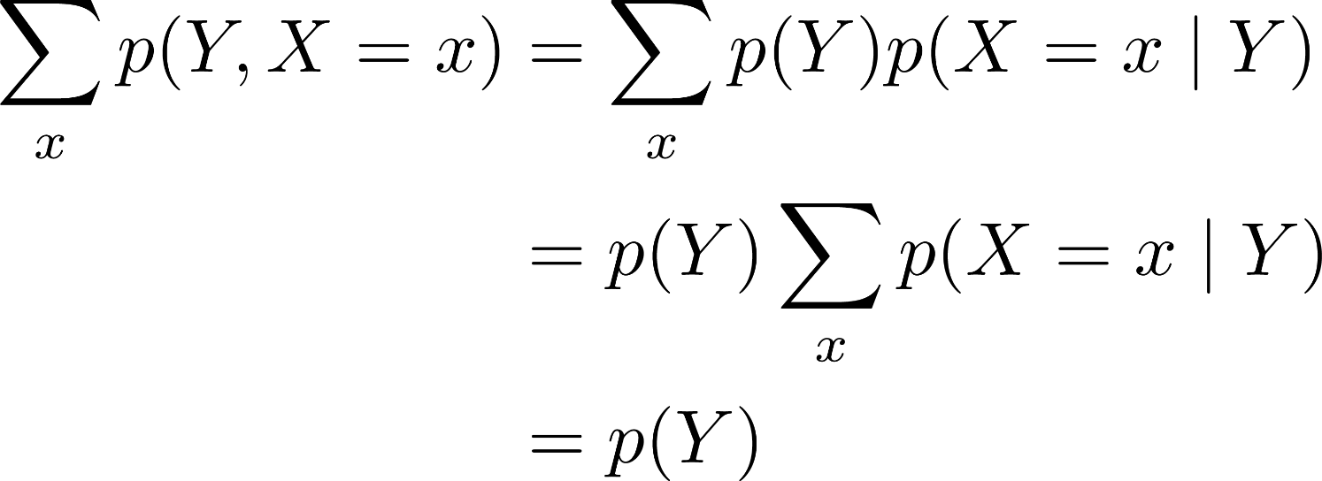
Fundamental Rules of Probability
Law of total probability
Proof
( chain rule )
( distributive property )
( axiom of probability )
Generalization for conditionals:

Slide 10
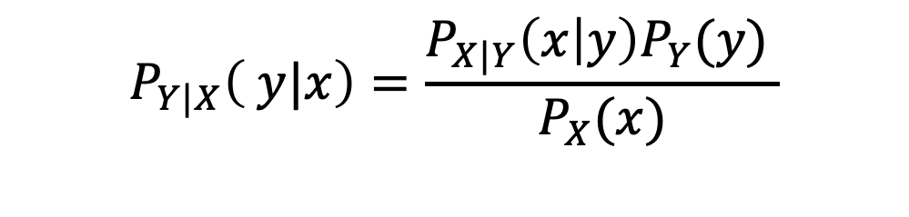
Fundamental Rules of Probability
Bayes Rule:
$$P_{Y|X}\left( y|x\right)=\frac{P_{X|Y}\left(x | y\right)P_{Y}(y) }{P_{X}(x)}$$

Slide 11

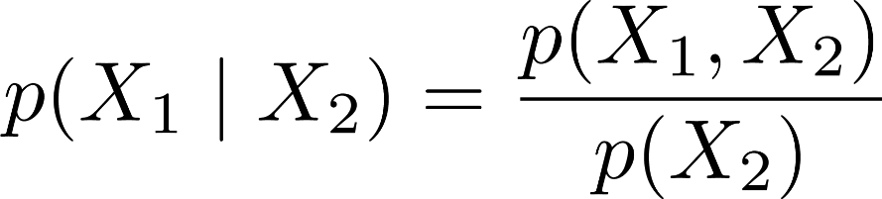
Independence of RVs
Question: Roll two dice and let their outcomes be
for die 1 and die 2, respectively. Recall the definition of conditional probability,
Which of the following are true? a)
b)
Outcome of die 2 doesn’t affect die 1
c)

Slide 12





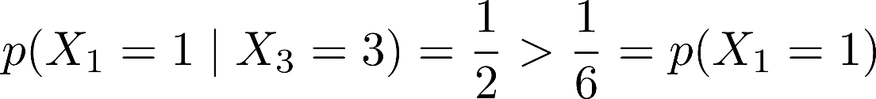
Independence of RVs
Question: Let
be outcome of die 1, as before. Now let be the sum of both dice. Which of the following are
true?
a)
Only 2 ways to get probability:
, each with equal
b)
c)
or
so

Slide 13



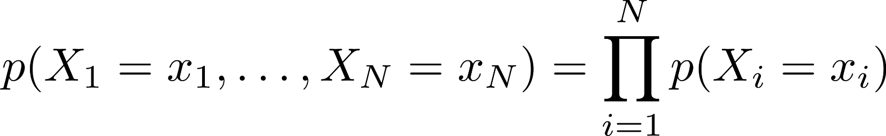

Independence of RVs
Definition Two random variables and are independent if and only if,
for all values and
Definition RVs
, and we say .
are mutually independent if and only if,
Independence is symmetric:
Equivalent definition of independence:

Slide 14
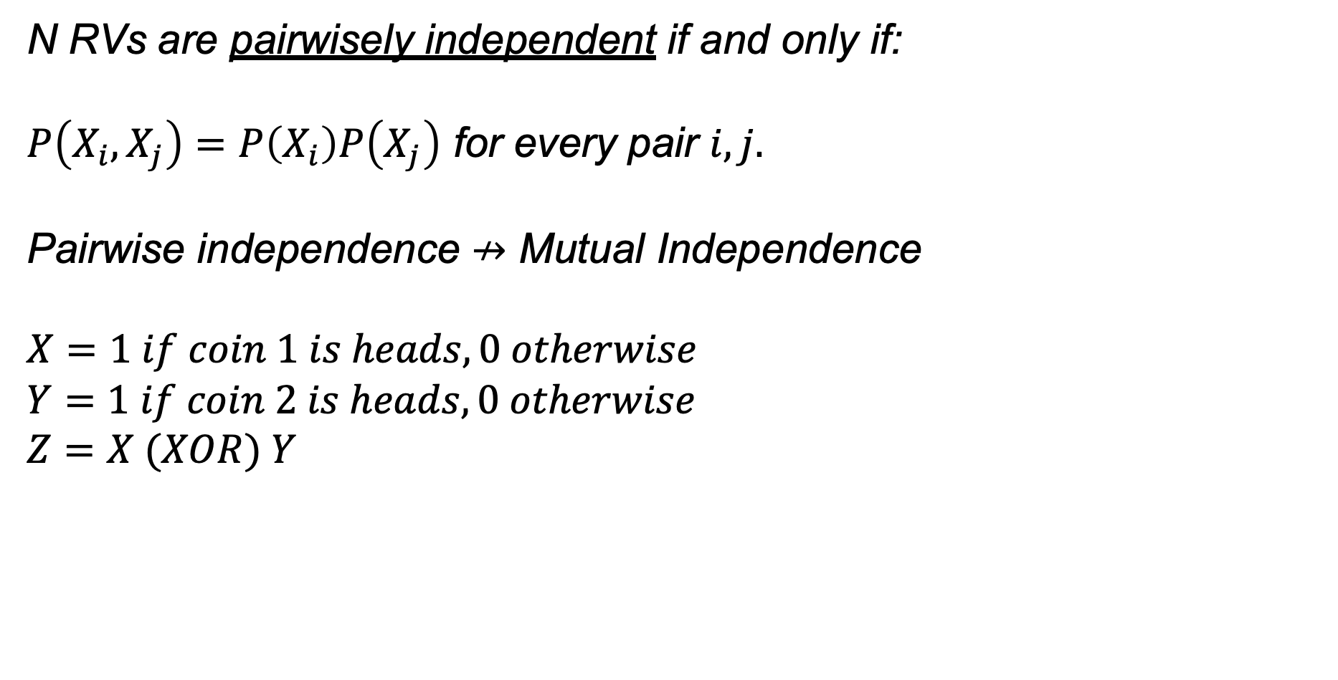
Independence of RVs
N RVs are pairwisely independent if and only if:
$P\left(X_{i},X_{j}\right)=P\left(X_{i}\right)P\left(X_{j}\right)$ for every pair $i, j.$
Pairwise independence $↛$ Mutual Independence
$$X=1 if coin 1 is heads, 0 otherwise$$
$$Y=1 if coin 2 is heads, 0 otherwise$$
$$Z=X (XOR) Y$$

Slide 15



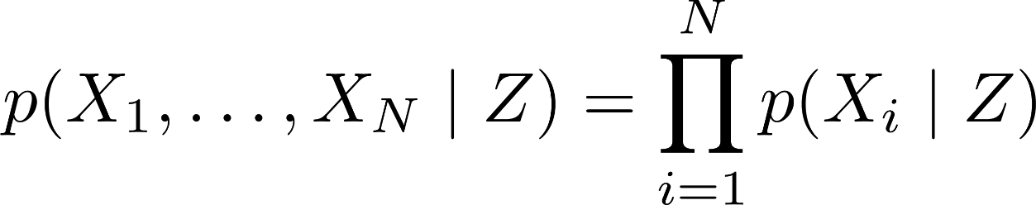

Independence of RVs
Definition Two random variables and are conditionally independent given if and only if,
for all values , , and , and we say that .
N RVs conditionally independent, given Z, if and only if:
Shorthand notation Implies for all x, y, z
Equivalent def’n of conditional independence:
Symmetric:

Slide 16
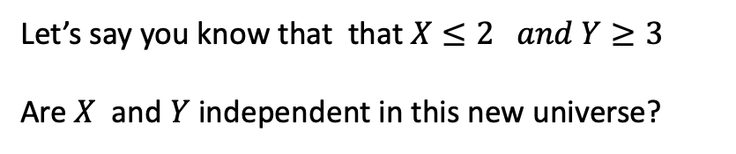
Conditional Independence
$$x$$
 | 1 | 2 | 3 | 4
4 | 1/20 | 2/20 | 2/20 | 0 | 5/20
3 | 2/20 | 4/20 | 1/20 | 2/20 | 9/20
2 | 0/20 | 2/20 | 1/20 | 0 | 3/20
1 | 0/20 | 1/20 | 2/20 | 0 | 3/20
 | 3/20 | 9/20 | 6/20 | 2/20
Let’s say you know that that $X≤2 and Y≥3$
Are $X$ and $Y$ independent in this new universe?
$$y$$
$X:H$eight 1: short, 2:normal, 3: tall, 4: very tall.
$Y:$Weight 1: light, 2:normal, 3: heavy, 4: very heavy

Slide 17
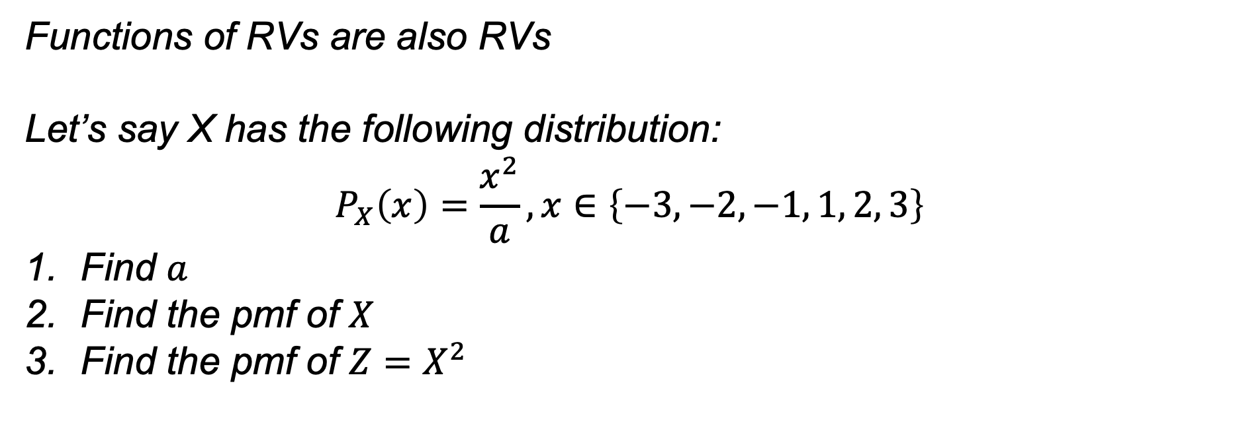
Functions of RVs
Functions of RVs are also RVs
Let’s say X has the following distribution:
$$P_{X}\left(x\right)=\frac{x^{2}}{a}, x∈\left\{−3,−2, −1, 1, 2, 3\right\}$$
Find $a$
Find the pmf of $X$
Find the pmf of $Z=X^{2}$

Slide 18
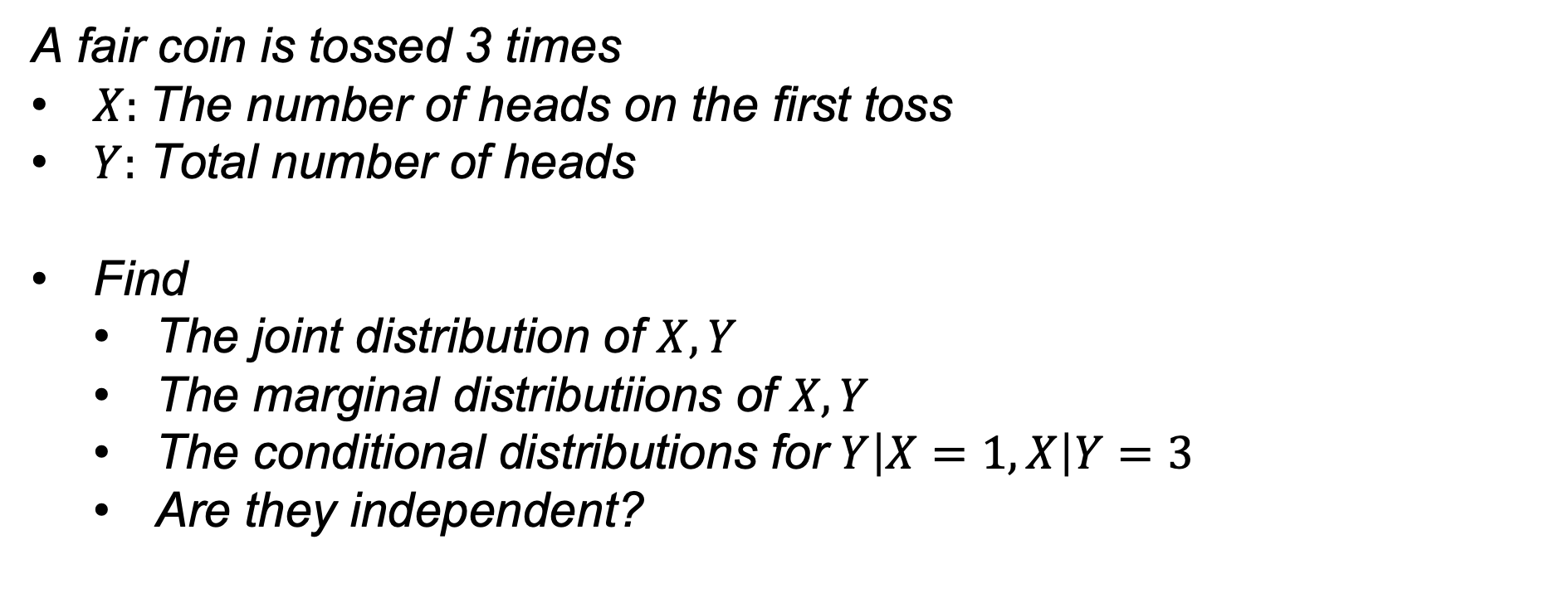
Practice
A fair coin is tossed 3 times
$X:$The number of heads on the first toss
$Y:$ Total number of heads
Find
  The joint distribution of $X, Y$
  The marginal distributiions of $X, Y$
  The conditional distributions for $Y\left|X=1, X\right|Y=3$
  Are they independent?

Slide 19

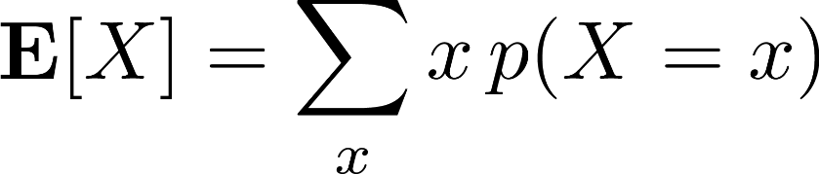
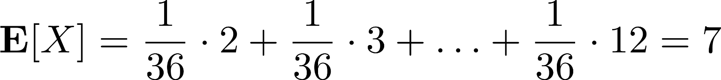
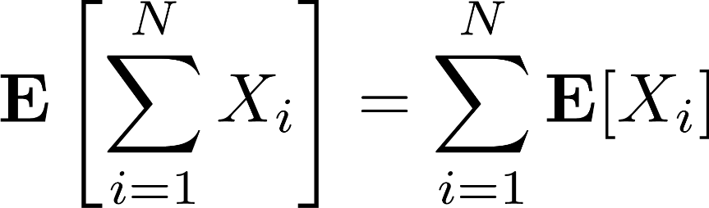

Expectation
Definition The expectation of a discrete RV , denoted by , is:
Summation over all values in domain of X
Example Let
be the sum of two fair dice, then:
Theorem (Linearity of Expectations) For any finite collection of discrete RVs with finite expectations,
Corollary For any constant c
E.g. for two RVs X and Y

Slide 20
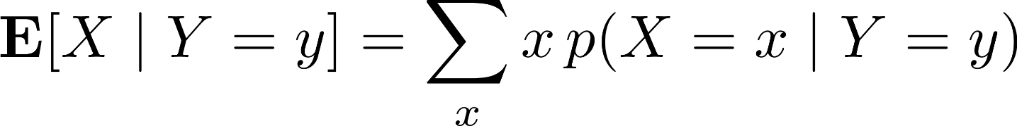
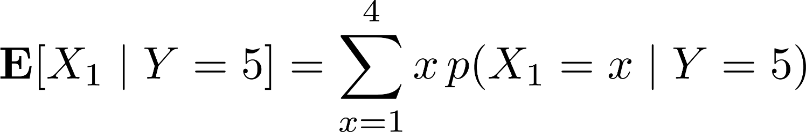
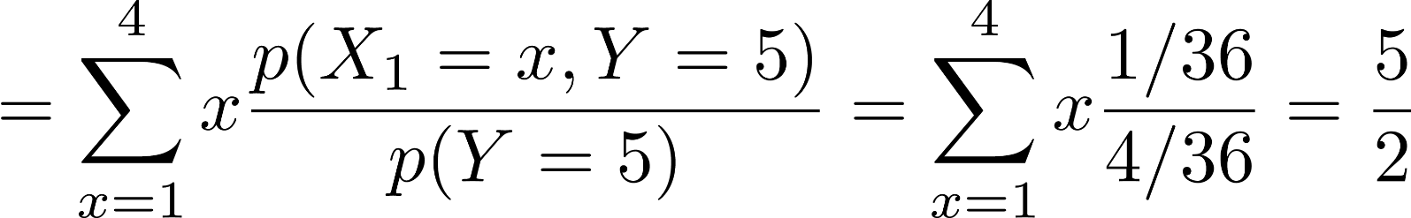
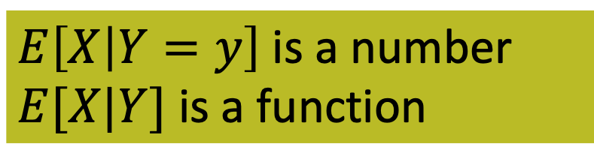
Conditional Expectation
Definition The conditional expectation of a discrete RV , given is:
Example Roll two standard six-sided dice and let be the result of the first die and let be the sum of both dice, then:
$E\left[X | Y=y\right]$ is a number
$E[X|Y]$ is a function
Conditional expectation follows properties of expectation (linearity, etc.)

Slide 21
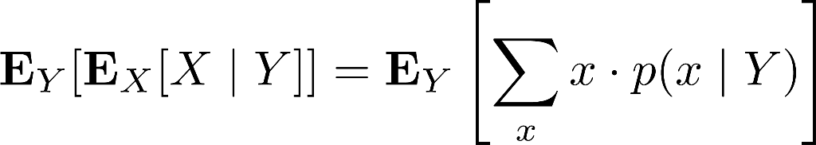
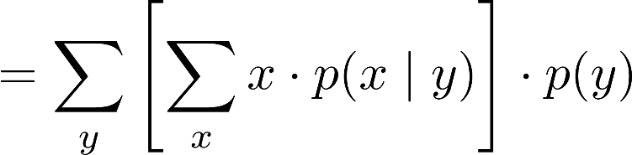
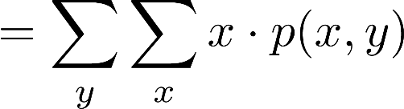
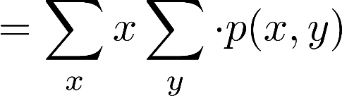
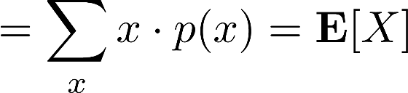
Law of Total Expectation
Law of Total Expectation Let and be discrete RVs with finite expectations, then:
Proof
( Definition of expectation )
( Probability chain rule )
( Linearity of expectations )
( Law of total probability )

Slide 22
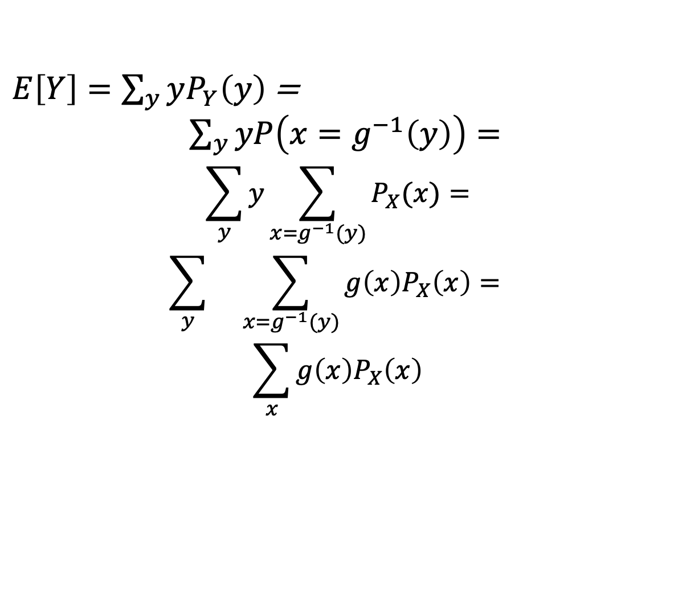
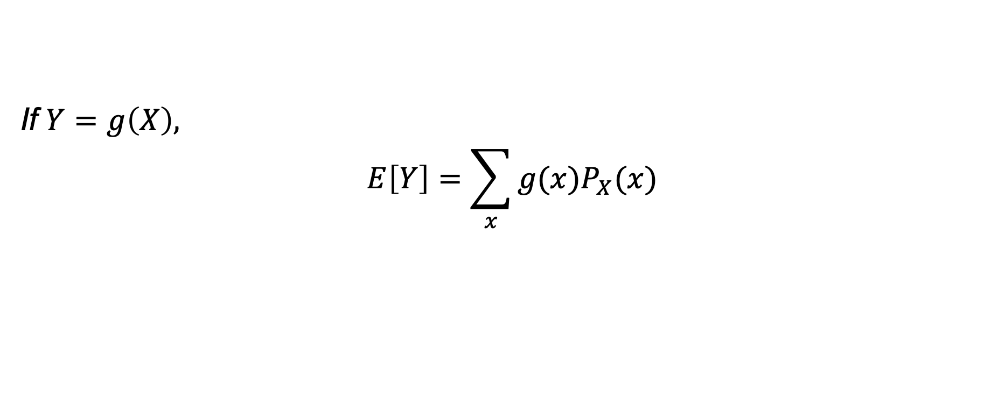
Law of the Unconsious Statistician
If $Y=g\left(X\right),$
$$E\left[Y\right]=\sum_{x}{g(x)P_{X}(x)}$$
Proof:
$E\left[Y\right]=\sum_{y}{yP_{Y}\left(y\right)}$ =
$\sum_{y}{yP\left(x=g^{−1}\left(y\right)\right)=}$
$$\sum_{y}{y}\sum_{x=g^{−1}(y)}{P_{X}(x)}=$$
$$\sum_{y}{}\sum_{x=g^{−1}(y)}{g\left(x\right)P_{X}\left(x\right)}=$$
$$\sum_{x}{g\left(x\right)P_{X}\left(x\right)}$$

Slide 23
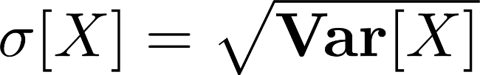
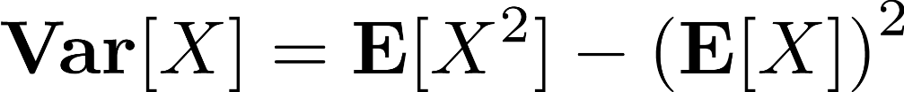


Variance
Definition The variance of a RV is defined as,
(X-units)²
The standard deviation is
.
(X-units)
Lemma An equivalent form of variance is:
Proof Keep in mind that
is a constant,
(Distributive property)
(Linearity of expectations) (Algebra)

Slide 24
Covariance
Definition The covariance of two RVs and is defined as,
Lemma For any two RVs and ,
e.g. variance is not a linear operator.
Proof
(Linearity of expectation) (Distributive property) (Linearity of expectation) (Definition of Var / Cov)

Slide 25
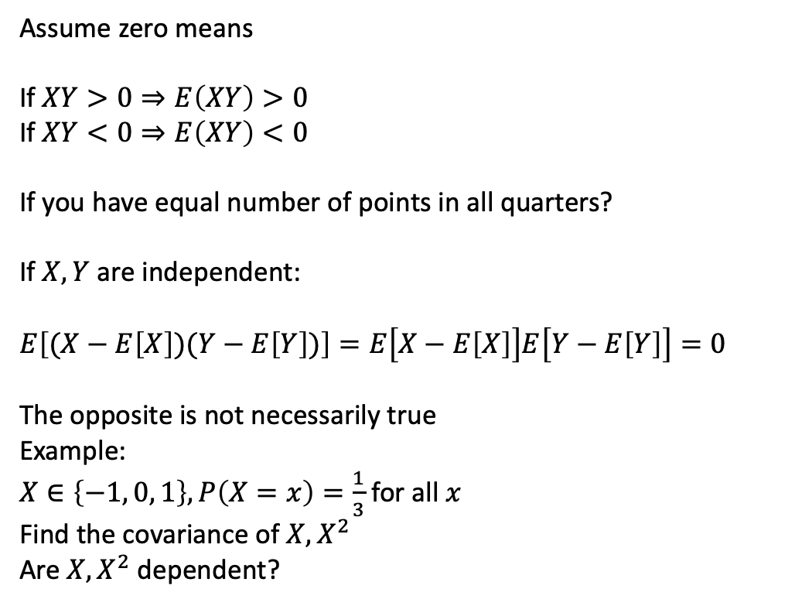
Covariance
Assume zero means
If $XY>0⇒E\left(XY\right)>0$
If $XY<0⇒E\left(XY\right)<0$
If you have equal number of points in all quarters?
If $X, Y$are independent:
$$E\left[(X−E\left[X\right])(Y−E\left[Y\right])\right]=E\left[X−E\left[X\right]\right]E\left[Y−E\left[Y\right]\right]=0$$
The opposite is not necessarily true
Example:
$X∈\left\{−1, 0, 1\right\}, P\left(X=x\right)=\frac{1}{3}$ for all $x$
Find the covariance of $X, X^{2}$
Are $X, X^{2}$dependent?

Slide 26
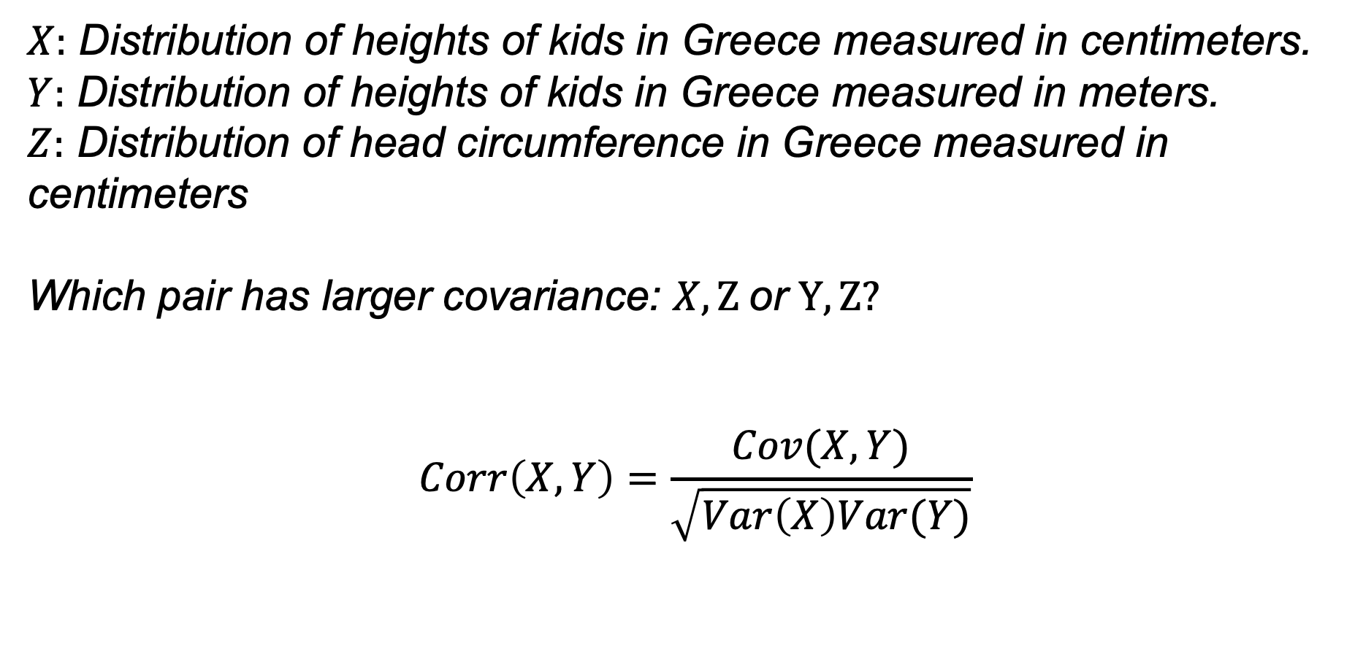
Correlation
$X:$ Distribution of heights of kids in Greece measured in centimeters.
$Y:$ Distribution of heights of kids in Greece measured in meters.
$Z:$ Distribution of head circumference in Greece measured in centimeters
Which pair has larger covariance: $X, Ζ$or $Y, Ζ?$
$$Corr\left(X, Y\right)=\frac{Cov(X, Y)}{\sqrt{Var\left(X\right)Var(Y)}}$$

Slide 27

Expectations of Products of Independent RVs
Theorem: If
then
.
Proof:
Example Let be RVs representing the result of rolling two fair standard die. What is the mean of their product?

Slide 28
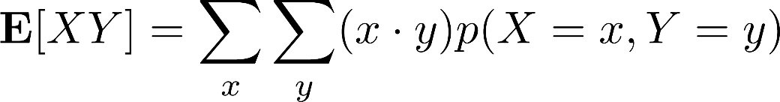
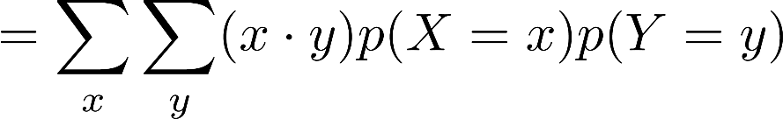
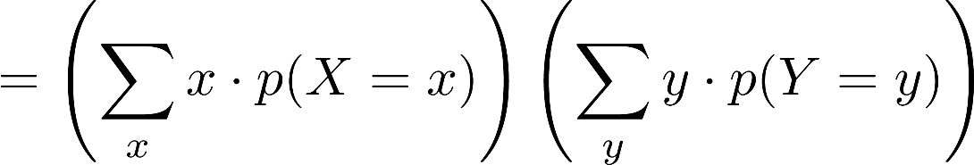

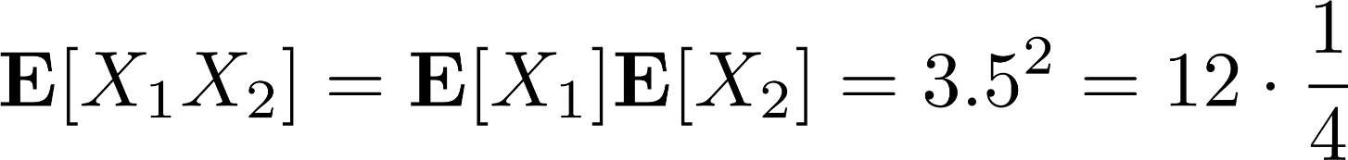
Expectations of Products of Independent RVs
Theorem: If
then
.
Proof:
( Independence )
( Linearity of Expectation )
Example Let be RVs representing the result of rolling two fair standard die. What is the mean of their product?

Slide 29


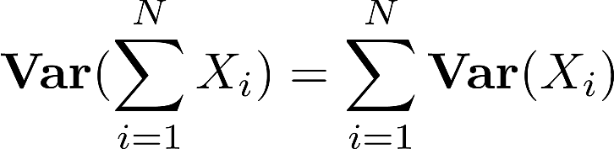
Variance of Sums of Distributions
Question: What is the variance of their sum?
Theorem: If
Corollary: If
then then
.
Corollary: For collection of RVs
:

Slide 30

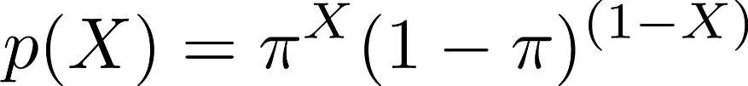

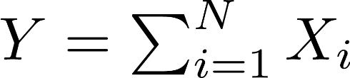

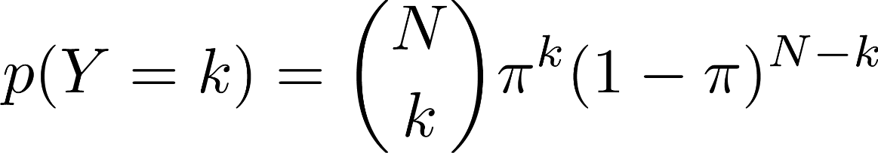

Useful Discrete Distributions
Bernoulli A.k.a. the coinflip distribution on binary RVs
Where
is the probability of success (e.g. heads), and also the mean
Suppose we flip N independent coins , what is the distribution over their sum
Num. “successes” out of N trials
Binomial Dist.
Num. ways to obtain k successes out of N
Binomial Mean:
Sum of means for N indep. Bernoulli RVs

Slide 31
Useful Discrete Distributions
Question: How many flips until we observe a success?

Slide 32

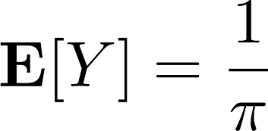


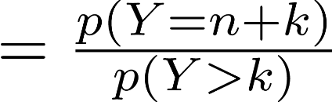
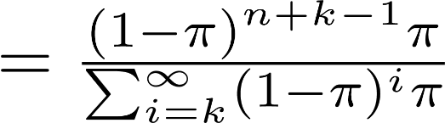
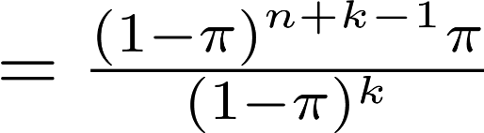



Useful Discrete Distributions
Question: How many flips until we observe a success?
Geometric Distribution on number of independent draws of
until success:
E.g. for fair coin
takes two flips on avg.
e.g. there must be n-1 failures (tails) before a success (heads).
Question: How many more flips of we have already seen k failures?
Corollary:

Slide 33









Useful Discrete Distributions
Categorical Distribution on integer-valued RV
or
with parameter
and Kronecker delta:
Can also represent X as one-hot binary vector,
where then
This representation is special case of the multinomial distribution

Slide 34




Useful Discrete Distributions
What if we count outcomes of N independent categorical RVs?
Multinomial Distribution on K-vector of counts of N repeated trials with PMF:
Number of ways to partition N objects into K groups:
Leading term ensures PMF is properly normalized:

Slide 35




Useful Discrete Distributions
A Poisson RV X with rate parameter has
the following distribution:
Mean and variance both scale with parameter
Represents number of times an event occurs in an interval of time or space.
Ex. Probability of overflow floods in 100 years,
Avg. 1 overflow flood every 100 years, makes setting rate parameter easy.
Lemma (additive closure) The sum of a finite number of Poisson RVs is a Poisson RV.

Slide 36












Useful Discrete Distributions
Theorem Let
constant . Then for any fixed k:
where
is a function of n and
for some
Proof Sketch Use Taylor expansion of and probability as a function of n:
to upper and lower bound Binomial
LB(n)
UB(n)
is constant. Then approaches 0. Therefore:
Bounds converge so result holds.
As and
it must be that
. The difference
so that
and

