Slide 1
Comparing means with ANOVA
Material: DeGroot and Schervish 9.7, 11.6
OpenStatistics Chapter 7.3
Slides adopted from Openintro.org

Slide 2
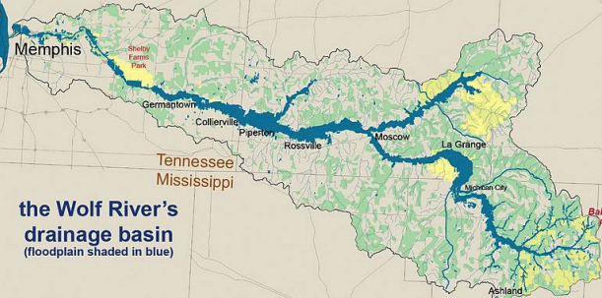
The Wolf River in Tennessee flows past an abandoned site once used by the pesticide industry for dumping wastes, including chlordane (pesticide), aldrin, and dieldrin (both insecticides)

Slide 3
The Wolf River in Tennessee flows past an abandoned site once used by the pesticide industry for dumping wastes, including chlordane (pesticide), aldrin, and dieldrin (both insecticides)
These highly toxic organic compounds can cause various cancers and birth defects

Slide 4
The Wolf River in Tennessee flows past an abandoned site once used by the pesticide industry for dumping wastes, including chlordane (pesticide), aldrin, and dieldrin (both insecticides)
These highly toxic organic compounds can cause various cancers and birth defects
The standard methods to test whether these substances are present in a river is to take samples at six-tenths depth

Slide 5
The Wolf River in Tennessee flows past an abandoned site once used by the pesticide industry for dumping wastes, including chlordane (pesticide), aldrin, and dieldrin (both insecticides)
These highly toxic organic compounds can cause various cancers and birth defects
The standard methods to test whether these substances are present in a river is to take samples at six-tenths depth
But since these compounds are denser than water and their molecules tend to stick to particles of sediment, they are more likely to be found in higher concentrations near the bottom

Slide 6
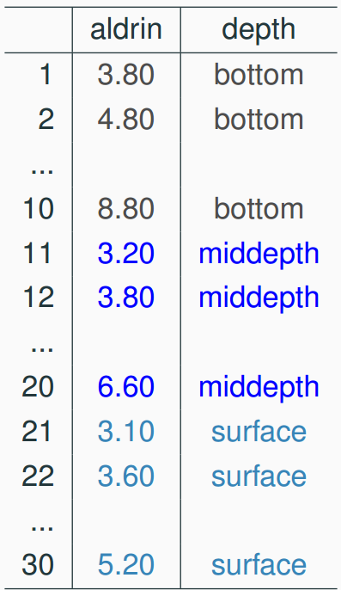
Data
Aldrin concentration (nanograms per liter) at three levels of depth

Slide 7
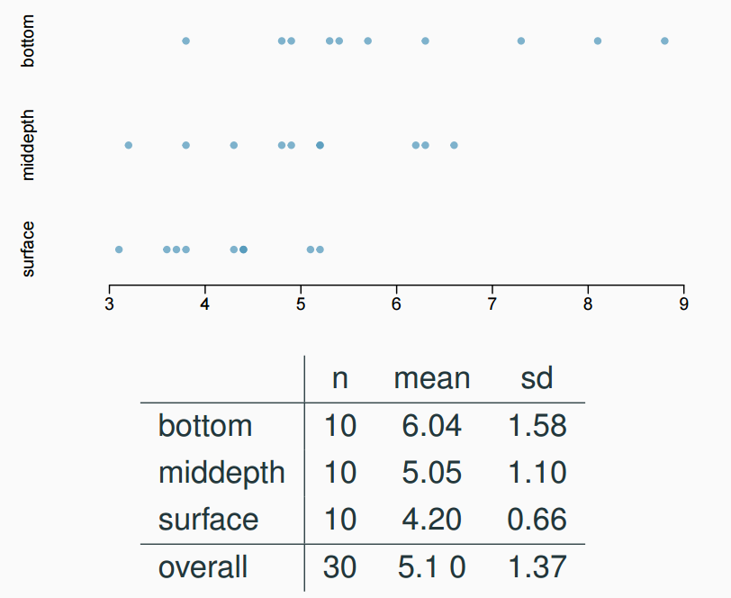
Exploratory analysis
Aldrin concentration (nanograms per liter) at three levels of depth

Slide 8
Research question
Is there a difference between the mean aldrin concentrations among the three levels?

Slide 9
Research question
Is there a difference between the mean aldrin concentrations among the three levels?
To compare means of 2 groups we use a Z or a T statistic

Slide 10
Research question
Is there a difference between the mean aldrin concentrations among the three levels?
To compare means of 2 groups we use a Z or a T statistic
To compare means of 3+ groups we use a new test called ANOVA and a new statistic called F

Slide 11
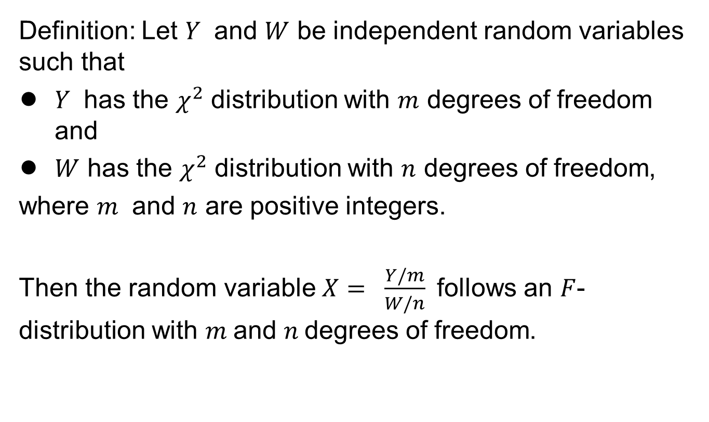
The F distributions
Definition: Let $Y$ and $W$ be independent random variables such that
$Y$ has the $χ^{2}$ distribution with $m$ degrees of freedom and
$W$ has the $χ^{2}$ distribution with $n$ degrees of freedom,
where $m$ and $n$ are positive integers.
Then the random variable$X= \frac{Y/m}{W/n}$ follows an $F$-distribution with $m$and $n$degrees of freedom.

Slide 12
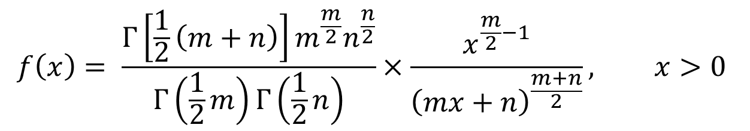
The F distributions
pdf:
$$f\left(x\right)= \frac{Γ\left[\frac{1}{2}\left(m+n\right)\right]m^{\frac{m}{2}}n^{\frac{n}{2}}}{Γ\left(\frac{1}{2}m\right)Γ\left(\frac{1}{2}n\right)}×\frac{x^{\frac{m}{2}−1}}{{\left(mx+n\right)}^{\frac{m+n}{2}}}, x>0$$
Python scipy.stats.f
Quantile using f.ppf

Slide 13
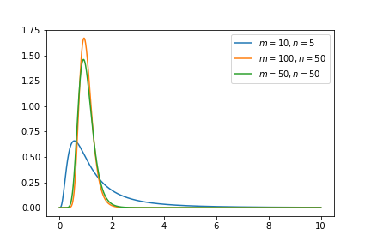
The F distributions

Slide 14

Comparing variances of two normals
Let $X∼N\left(μ_{1},σ_{1}^{2}\right)$ and $Y∼N(μ_{2},σ_{2}^{2})$
Reminder: $\frac{S_{x}^{2}}{σ_{x}^{2}}∼χ_{n−1}^{2}$, where $S_{x}^{2}=\sum_{i=1}^{n}{{\left(x_{i}−\overline{x}\right)}^{2}}$

Slide 15
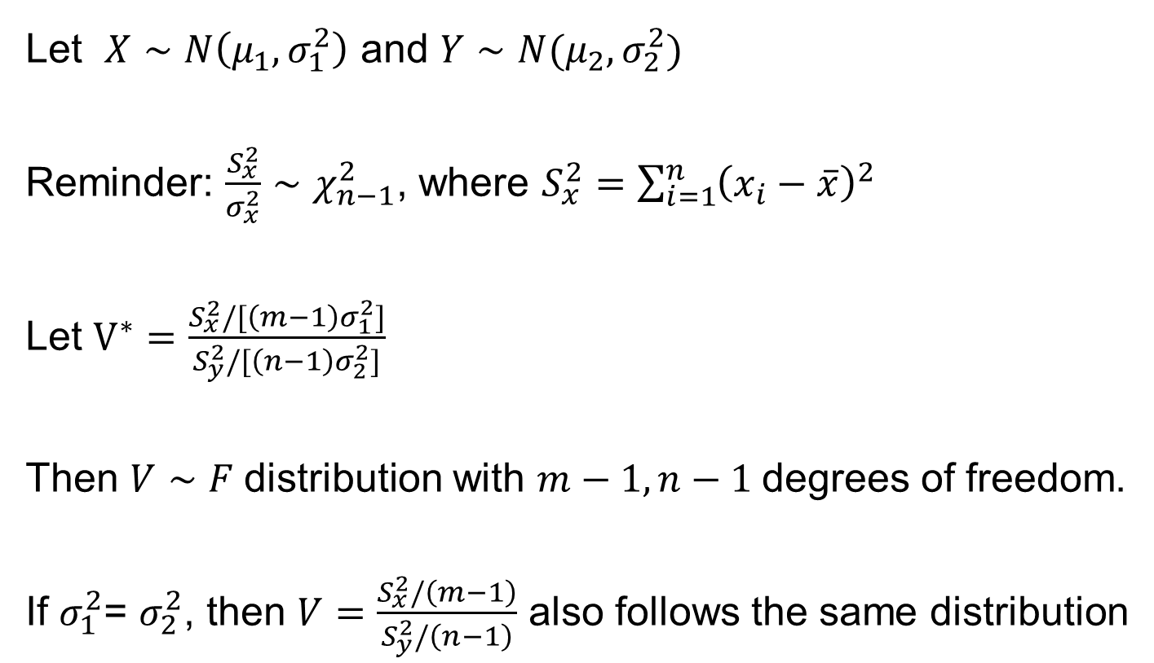
Comparing variances of two normals
Let $X∼N\left(μ_{1},σ_{1}^{2}\right)$ and $Y∼N(μ_{2},σ_{2}^{2})$
Reminder: $\frac{S_{x}^{2}}{σ_{x}^{2}}∼χ_{n−1}^{2}$, where $S_{x}^{2}=\sum_{i=1}^{n}{{\left(x_{i}−\overline{x}\right)}^{2}}$
Let $V^{∗}=\frac{S_{x}^{2}/[\left(m−1\right)σ_{1}^{2}]}{S_{y}^{2}/[\left(n−1\right)σ_{2}^{2}]}$
Then $V∼F$distribution with $m−1, n−1$degrees of freedom.
If $σ_{1}^{2}$= $σ_{2}^{2}$, then $V=\frac{S_{x}^{2}/\left(m−1\right)}{S_{y}^{2}/\left(n−1\right)}$ also follows the same distribution

Slide 16
ANOVA
ANOVA is used to assess whether the mean of the outcome variable is different for different levels of a categorical variable

Slide 17
ANOVA
ANOVA is used to assess whether the mean of the outcome variable is different for different levels of a categorical variable
H₀ : The mean outcome is the same across all categories,
𝜇₁ = 𝜇₂ = … = 𝜇_{k},
where 𝜇_{i} represents the mean of the outcome for observations in category i
H_{A} : At least one mean is different than others

Slide 18
z/𝘵 test vs. ANOVA - Purpose
z/𝘵 test
Compare means from two groups to see whether they are so far apart that the observed difference cannot reasonably be attributed to sampling variability
H₀ : 𝜇₁ = 𝜇₂
ANOVA
Compare the means from two or more groups to see whether they are so far apart that the observed differences cannot all reasonably be attributed to sampling variability
H₀ : 𝜇₁ = 𝜇₂ = … = 𝜇_{k}

Slide 19


z/𝘵 test vs. ANOVA - Method
z/𝘵 test
Compute a test statistic (a ratio)
ANOVA
Compute a test statistic (a ratio)

Slide 20
z/𝘵 test vs. ANOVA - Method
z/𝘵 test
Compute a test statistic (a ratio)
ANOVA
Compute a test statistic (a ratio)
Large test statistics lead to small p-values
If the p-value is small enough H₀ is rejected, we conclude that the population means are not equal

Slide 21
z/𝘵 test vs. ANOVA
With only two groups t-test and ANOVA are equivalent, but only if we use a pooled standard variance in the denominator of the test statistic
With more than two groups, ANOVA compares the sample means to an overall grand mean

Slide 22
Hypotheses
H₀ : 𝜇_{B} = 𝜇_{M} = 𝜇_{S}
H_{A} : 𝜇_{B} ≠ 𝜇_{M} ≠ 𝜇_{S}
H₀ : 𝜇_{B} ≠ 𝜇_{M} ≠ 𝜇_{S}
H_{A} : 𝜇_{B} = 𝜇_{M} = 𝜇_{S}
H₀ : 𝜇_{B} = 𝜇_{M} = 𝜇_{S}
H_{A} : At least one mean is different
H₀ : 𝜇_{B} = 𝜇_{M} = 𝜇_{S} = 0
H_{A} : At least one mean is different
H₀ : 𝜇_{B} = 𝜇_{M} = 𝜇_{S}
H_{A} : 𝜇_{B} > 𝜇_{M} > 𝜇_{S}

Slide 23
Hypotheses
H₀ : 𝜇_{B} = 𝜇_{M} = 𝜇_{S}
H_{A} : 𝜇_{B} ≠ 𝜇_{M} ≠ 𝜇_{S}
H₀ : 𝜇_{B} ≠ 𝜇_{M} ≠ 𝜇_{S}
H_{A} : 𝜇_{B} = 𝜇_{M} = 𝜇_{S}
H₀ : 𝜇_{B} = 𝜇_{M} = 𝜇_{S}
H_{A} : At least one mean is different
H₀ : 𝜇_{B} = 𝜇_{M} = 𝜇_{S} = 0
H_{A} : At least one mean is different
H₀ : 𝜇_{B} = 𝜇_{M} = 𝜇_{S}
H_{A} : 𝜇_{B} > 𝜇_{M} > 𝜇_{S}

Slide 24
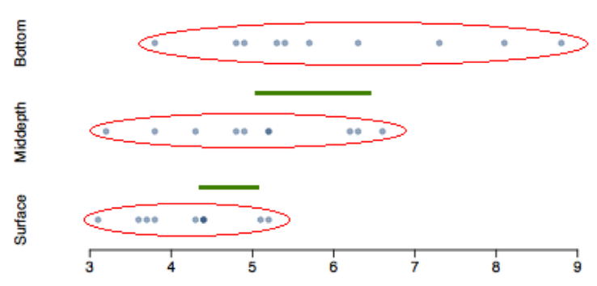
Test statistic
Does there appear to be a lot of variability within groups? How about between groups?

Slide 25

Measuring variability
Total:
$$SST=\sum_{i}{{\left(x_{i}−\overline{x}\right)}^{2}}$$
Between Groups:
$$SSG=\sum_{i=1}^{p}{n_{i}{\left(\overline{x_{i}} −\overline{x}\right)}^{2}}$$
Residual:
$$SSE=\sum_{i=1}^{p}{\sum_{j=1}^{n_{i}}{{\left(x_{ij}−\overline{x_{i}}\right)}^{2}}}$$

Slide 26
Measuring variability
Total:
$$SST=\sum_{i}{{\left(x_{i}−\overline{x}\right)}^{2}}$$
Between Groups:
$$SSG=\sum_{i=1}^{p}{n_{i}{\left(\overline{x_{i}} −\overline{x}\right)}^{2}}$$
Residual:
$$SSE=\sum_{i=1}^{p}{\sum_{j=1}^{n_{i}}{{\left(x_{ij}−\overline{x_{i}}\right)}^{2}}}$$
$$SST=SSG+SSE$$

Slide 27
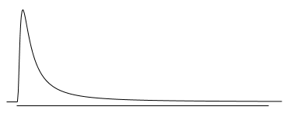
𝑭 distribution and p-value
Large values of the F statistic lead to small p-values, which leads to rejecting In order to be able to reject H₀, we need a small p-value, which requires a large F statistic
In order to obtain a large F statistic, variability between sample means needs to be greater than variability within sample means

Slide 28
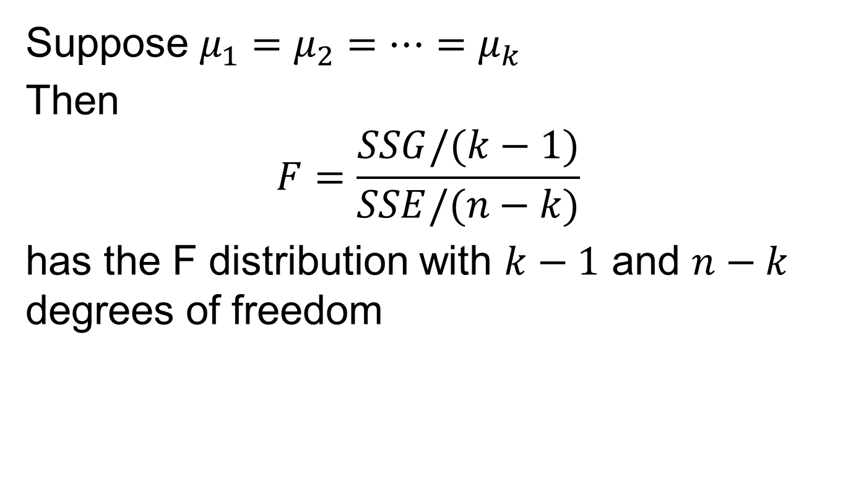
Theorem
Suppose $μ_{1}=μ_{2}=…=μ_{k}$
Then
$$F=\frac{SSG/(k−1)}{SSE/(n−k)}$$
has the F distribution with $k−1$ and $n−k$ degrees of freedom

Slide 29
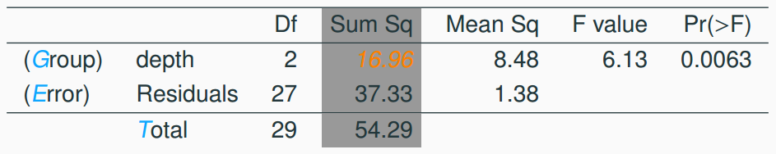



Sum of squares between groups, SSG
Measures the variability between groups
where is each group size, is the average for each group, is the overall (grand) mean

Slide 30
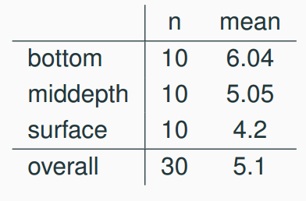
Sum of squares between groups, SSG
Measures the variability between groups
where is each group size, is the average for each group, is the overall (grand) mean

Slide 31

Sum of squares between groups, SSG
Measures the variability between groups
where is each group size, is the average for each group, is the overall (grand) mean

Slide 32

Sum of squares between groups, SSG
Measures the variability between groups
where is each group size, is the average for each group, is the overall (grand) mean

Slide 33

Sum of squares between groups, SSG
Measures the variability between groups
where is each group size, is the average for each group, is the overall (grand) mean

Slide 34
Sum of squares between groups, SSG
Measures the variability between groups
where is each group size, is the average for each group, is the overall (grand) mean

Slide 35

Sum of squares between groups, SSG
Measures the variability between groups
where is each group size, is the average for each group, is the overall (grand) mean

Slide 36
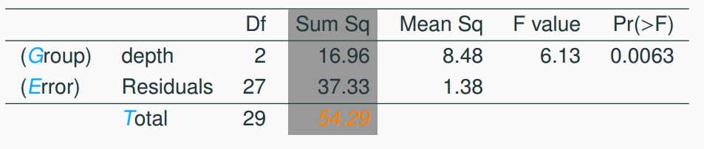
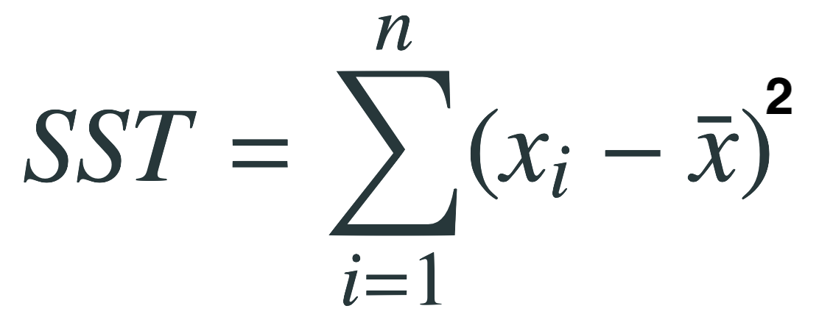
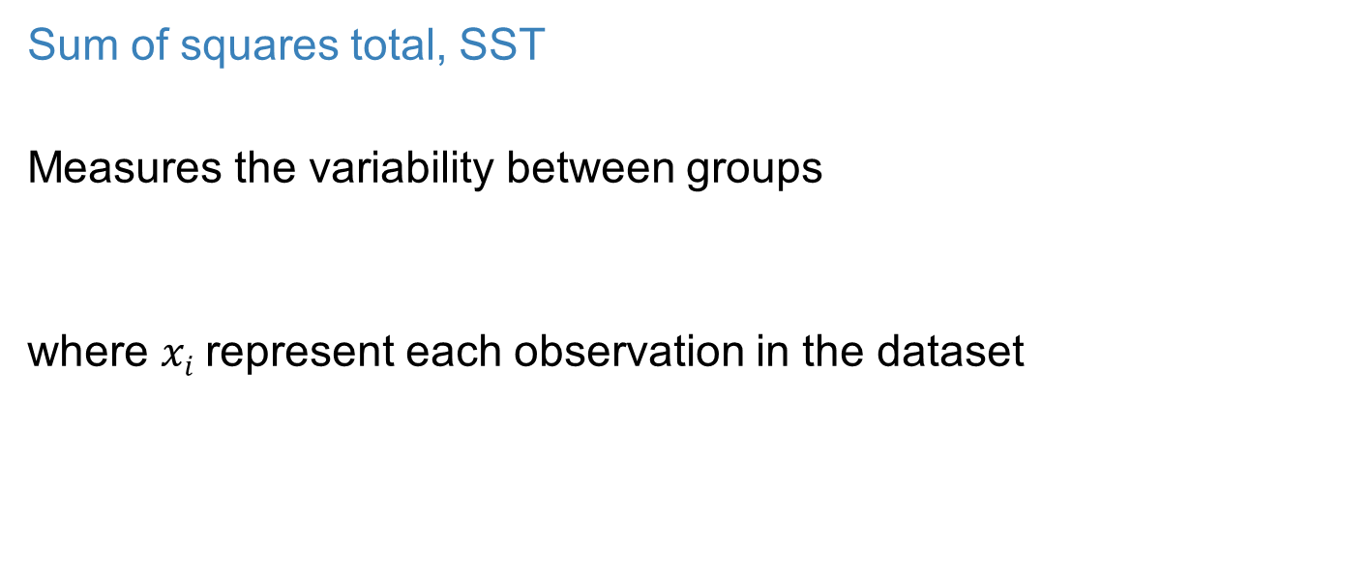
Sum of squares total, SST
Measures the variability between groups
where $xi$represent each observation in the dataset

Slide 37
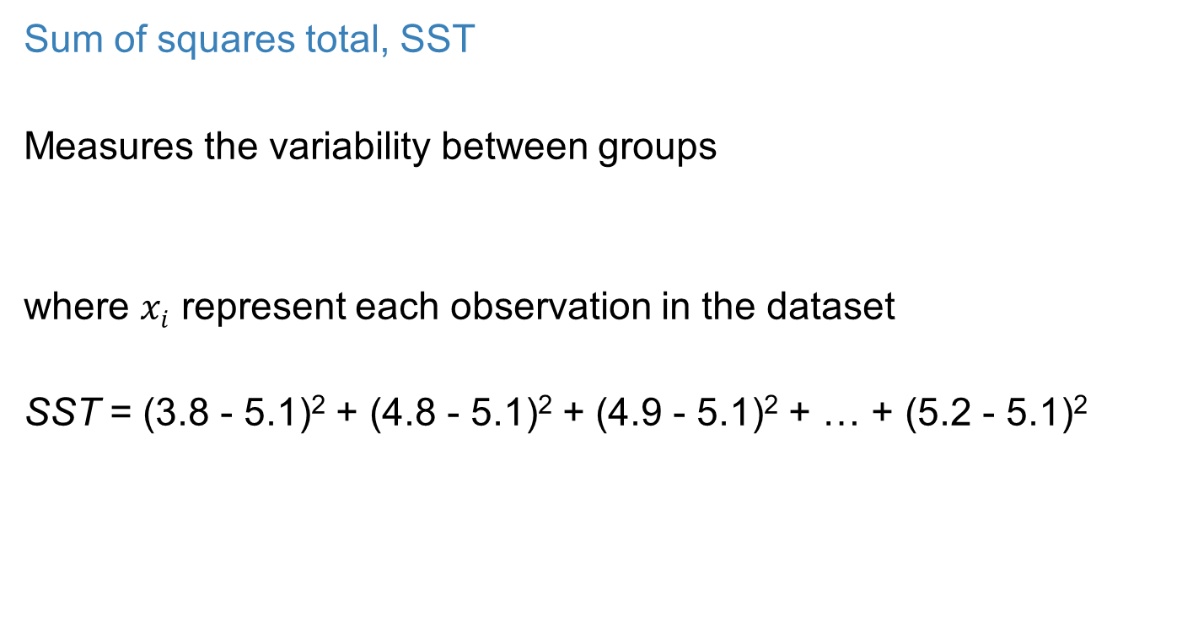
Sum of squares total, SST
Measures the variability between groups
where $xi$ represent each observation in the dataset
SST = (3.8 - 5.1)² + (4.8 - 5.1)² + (4.9 - 5.1)² + … + (5.2 - 5.1)²

Slide 38
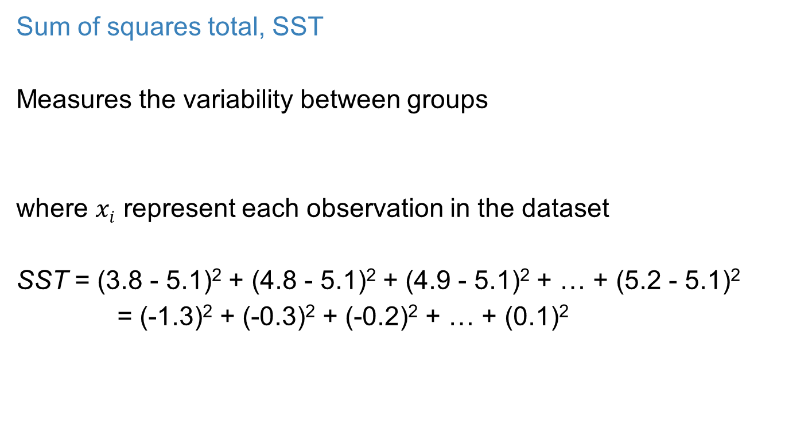
Sum of squares total, SST
Measures the variability between groups
where $xi$ represent each observation in the dataset
SST = (3.8 - 5.1)² + (4.8 - 5.1)² + (4.9 - 5.1)² + … + (5.2 - 5.1)²
= (-1.3)² + (-0.3)² + (-0.2)² + … + (0.1)²

Slide 39
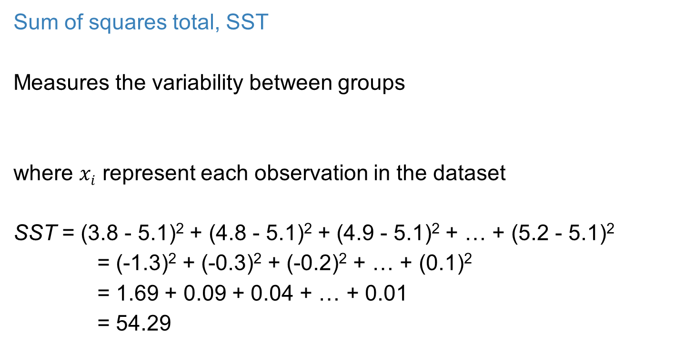
Sum of squares total, SST
Measures the variability between groups
where $xi$ represent each observation in the dataset
SST = (3.8 - 5.1)² + (4.8 - 5.1)² + (4.9 - 5.1)² + … + (5.2 - 5.1)²
= (-1.3)² + (-0.3)² + (-0.2)² + … + (0.1)²
= 1.69 + 0.09 + 0.04 + … + 0.01
= 54.29

Slide 40
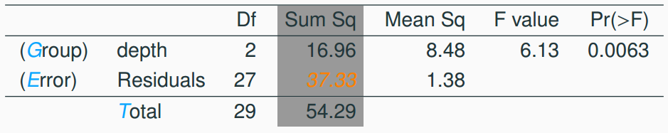

Sum of squares error, SSE
Measures the variability within groups:
$$SSE = SST − SSG$$

Slide 41

Sum of squares error, SSE
Measures the variability within groups:
$$SSE = SST − SSG$$
$$SSE = 54.29 − 16.96 = 37.33$$

Slide 42
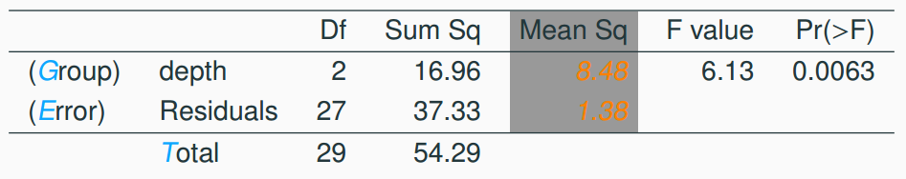
Mean square error
Mean square error is calculated as sum of squares divided by the degrees of freedom

Slide 43
Mean square error
Mean square error is calculated as sum of squares divided by the degrees of freedom
MSG = 16.96/2 = 8.48

Slide 44
Mean square error
Mean square error is calculated as sum of squares divided by the degrees of freedom
MSG = 16.96/2 = 8.48
MSE = 37.33/27 = 1.38

Slide 45
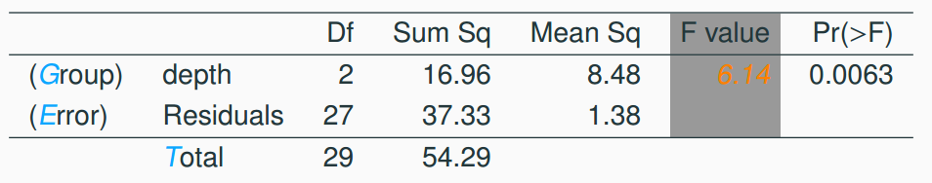

Test statistic, F value
As we discussed before, the F statistic is the ratio of the between group and within group variability

Slide 46

Test statistic, F value
As we discussed before, the F statistic is the ratio of the between group and within group variability

Slide 47
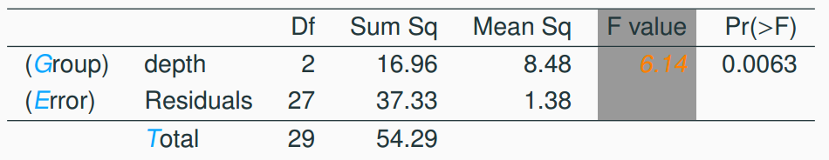
p-value
p-value is the probability of at least as large a ratio between the “between group” and “within group” variability, if in fact the means of all groups are equal. It’s calculated as the area under the F curve, with degrees of freedom df_{G} and df_{E}, above the observed F statistic.

Slide 48
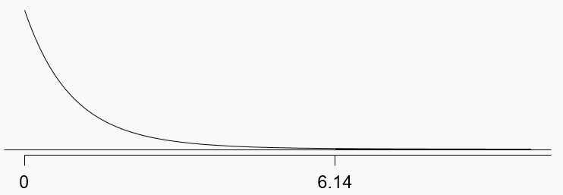
p-value
p-value is the probability of at least as large a ratio between the “between group” and “within group” variability, if in fact the means of all groups are equal. It’s calculated as the area under the F curve, with degrees of freedom df_{G} and df_{E}, above the observed F statistic.
df_{G} = 2; df_{E} = 27

Slide 49
Conclusion - in context
What is the conclusion of the hypothesis test?
The data provide convincing evidence that the average aldrin concentration
is different for all groups
on the surface is lower than the other levels
is different for at least one group
is the same for all groups

Slide 50
Conclusion - in context
What is the conclusion of the hypothesis test?
The data provide convincing evidence that the average aldrin concentration
is different for all groups
on the surface is lower than the other levels
is different for at least one group
is the same for all groups

Slide 51
Conclusion
If p-value is small (less than α), reject H₀. The data provide convincing evidence that at least one mean is different from (but we can’t tell which one)

Slide 52
Conclusion
If p-value is small (less than α), reject H₀. The data provide convincing evidence that at least one mean is different from (but we can’t tell which one)
If p-value is large, fail to reject H₀. The data do not provide convincing evidence that at least one pair of means are different from each other, the observed differences in sample means are attributable to sampling variability (or chance)

Slide 53
Conditions
The observations should be independent within and between groups
If the data are a simple random sample from less than 10% of the population, this condition is satisfied
Carefully consider whether the data may be independent (e.g. no pairing)
Always important, but sometimes difficult to check

Slide 54
Conditions
The observations should be independent within and between groups
If the data are a simple random sample from less than 10% of the population, this condition is satisfied
Carefully consider whether the data may be independent (e.g. no pairing)
Always important, but sometimes difficult to check
The observations within each group should be nearly normal
Especially important when the sample sizes are small
How do we check for normality?

Slide 55
Conditions
The observations should be independent within and between groups
If the data are a simple random sample from less than 10% of the population, this condition is satisfied
Carefully consider whether the data may be independent (e.g. no pairing)
Always important, but sometimes difficult to check
The observations within each group should be nearly normal
Especially important when the sample sizes are small
How do we check for normality?
The variability across the groups should be about equal
Especially important when the sample sizes differ between groups
How can we check this condition?

Slide 56
independence
Does this condition appear to be satisfied?

Slide 57
independence
Does this condition appear to be satisfied?
In this study the we have no reason to believe that the aldrin concentration won’t be independent of each other

Slide 58
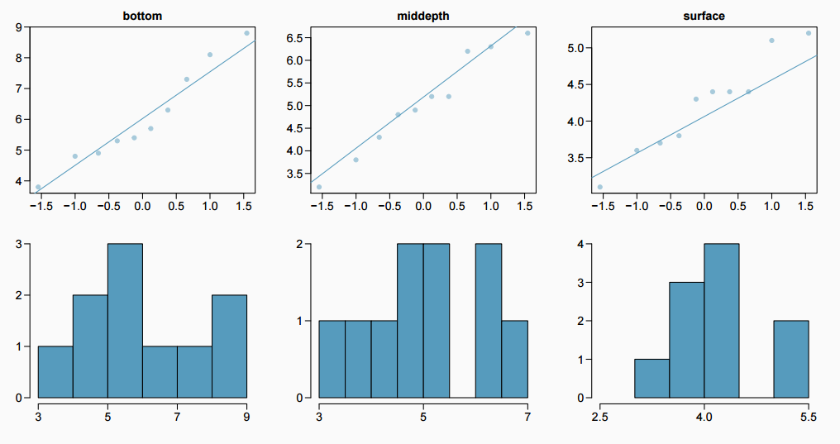
approximately normal
Does this condition appear to be satisfied?

Slide 59
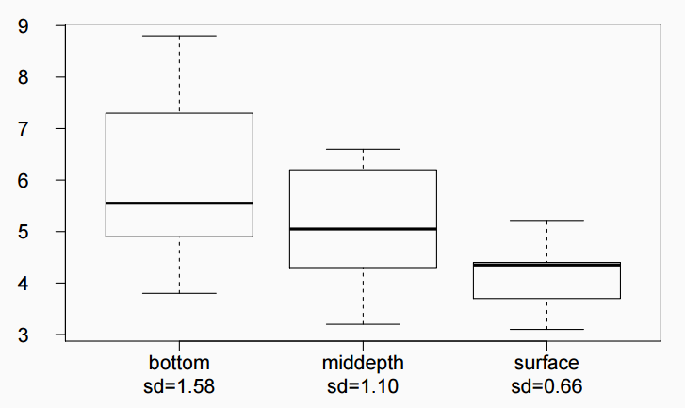
constant variance
Does this condition appear to be satisfied?

Slide 60
Which means differ?
Earlier we concluded that at least one pair of means differ. The natural question that follows is “which ones?”

Slide 61
Which means differ?
Earlier we concluded that at least one pair of means differ. The natural question that follows is “which ones?”
We can do two sample 𝘵 tests for differences in each possible pair of groups

Slide 62
Which means differ?
Earlier we concluded that at least one pair of means differ. The natural question that follows is “which ones?”
We can do two sample 𝘵 tests for differences in each possible pair of groups
Can you see any pitfalls with this approach?

Slide 63
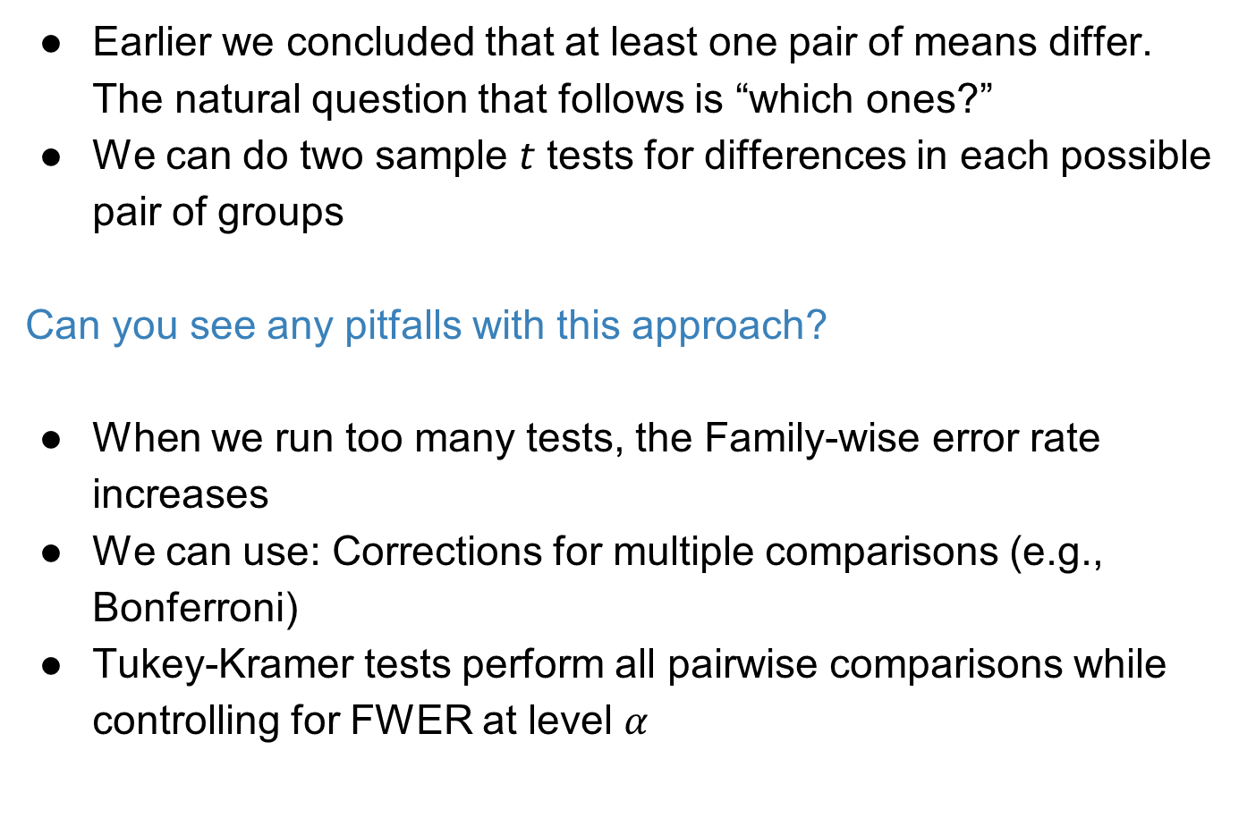
Which means differ?
Earlier we concluded that at least one pair of means differ. The natural question that follows is “which ones?”
We can do two sample 𝘵 tests for differences in each possible pair of groups
Can you see any pitfalls with this approach?
When we run too many tests, the Family-wise error rate increases
We can use: Corrections for multiple comparisons (e.g., Bonferroni)
Tukey-Kramer tests perform all pairwise comparisons while controlling for FWER at level $α$

Slide 64
Why not just use pairwise comparisons?
Controlling for family-wise error rate is conservative
It may be the case that we end up getting no significant p-values in pairwise comparisons, but a significant ANOVA p-value

Slide 65
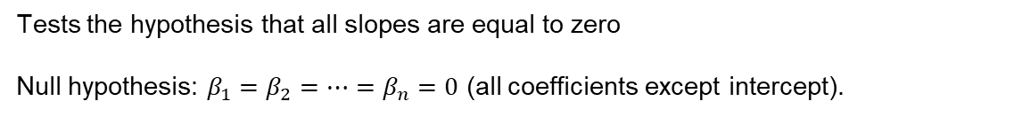
Back to multiple linear regression
Coefficients:
 | Estimate | Std. Error | t value | Pr(>|t|)
(Intercept) | 197.96284 | 59.19274 | 3.344 | 0.005841 | **
volume | 0.71795 | 0.06153 | 11.669 | 6.6e-08 | ***
cover:pb | -184.04727 | 40.49420 | -4.545 | 0.000672 | ***
Residual standard error: 78.2 on 12 degrees of freedom Multiple R-squared: 0.9275,Adjusted R-squared: 0.9154
F-statistic: 76.73 on 2 and 12 DF, p-value: 1.455e-07
Tests the hypothesis that all slopes are equal to zero
Null hypothesis: $β_{1}=β_{2}=…=β_{n}=0$ (all coefficients except intercept).

