Slide 1
Lecture Summary
Frequentist Inference
Maximum Likelihood Estimation
Confidence Intervals
Material in DeGroot and Schervish Chapter 7.1-7.4

Slide 2
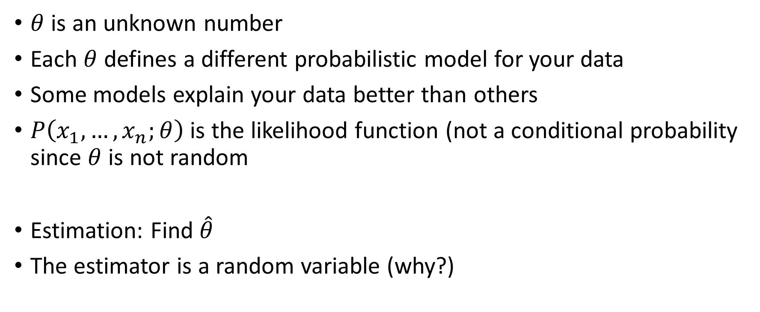
Frequentist Approach to estimation
$θ$ is an unknown number
Each $θ$ defines a different probabilistic model for your data
Some models explain your data better than others
$P\left(x_{1},…, x_{n};θ\right)$ is the likelihood function (not a conditional probability since $θ$ is not random
Estimation: Find $\hat{θ}$
The estimator is a random variable (why?)

Slide 3
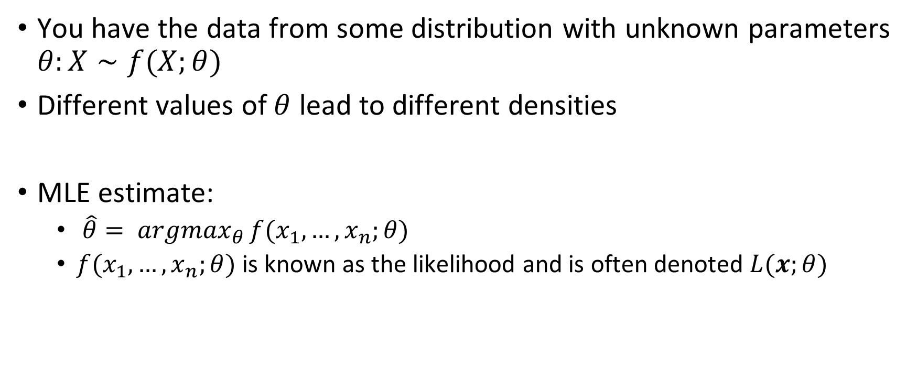
Maximum Likelihood Estimation
You have the data from some distribution with unknown parameters $θ:X∼f(X;θ)$
Different values of $θ$ lead to different densities
MLE estimate:
$\hat{θ}= argmax_{θ}{f(x_{1},…, x_{n};θ) }$
$f(x_{1},…, x_{n};θ)$ is known as the likelihood and is often denoted $L(x;θ)$

Slide 4
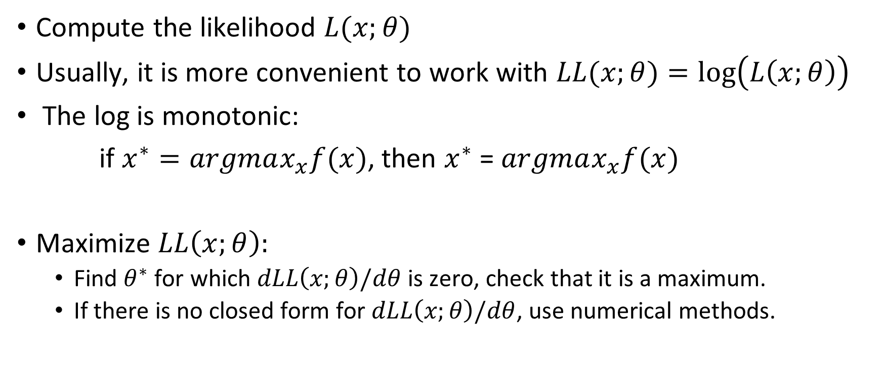
Steps to MLE
Compute the likelihoοd $L(x;θ)$
Usually, it is more convenient to work with $LL(x;θ)=\log\left(L\left(x;θ\right)\right)$
The log is monotonic:
if $x^{∗}=argmax_{x}f(x)$, then $x^{∗}$ = $argmax_{x}f(x)$
Maximize $LL\left(x;θ\right):$
Find $θ^{∗}$ for which $dLL\left(x;θ\right)/dθ$ is zero, check that it is a maximum.
If there is no closed form for $dLL\left(x;θ\right)/dθ$, use numerical methods.

Slide 5
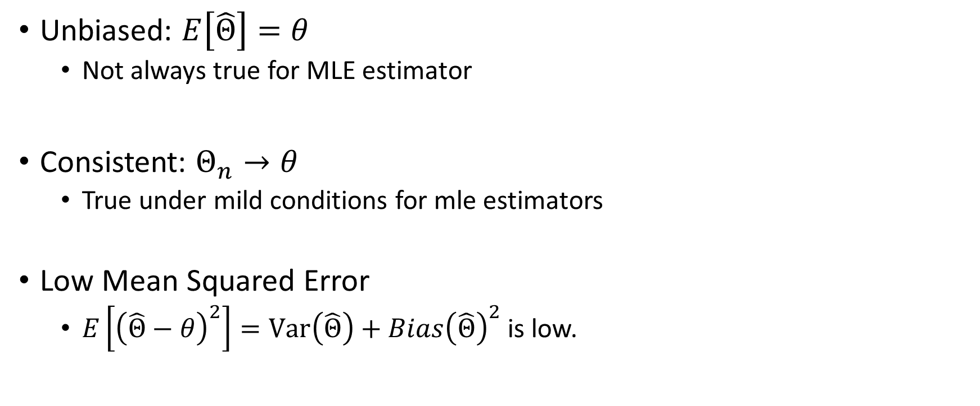
Desired properties of estimators
Unbiased: $E\left[\hat{Θ}\right]=θ$
Not always true for MLE estimator
Consistent: $Θ_{n}→θ$
True under mild conditions for mle estimators
Low Mean Squared Error
$E\left[{\left(\hat{Θ}−θ\right)}^{2}\right]=Var\left(\hat{Θ}\right)+Bias{\left(\hat{Θ}\right)}^{2}$ is low.

