Slide 1
Linear Regression

Slide 2
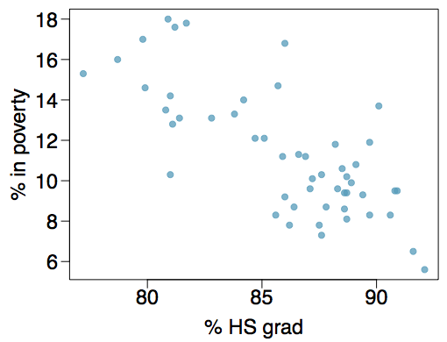
Poverty vs. HS graduate rate
The scatterplot below shows the relationship between HS graduate rate in all 50 US states and DC and the percent of residents who live below the poverty line
(income below $23,050 for a family of 4 in 2012).
Response variable?
% in poverty
Explanatory variable?
% HS grad
Relationship?
linear

Slide 3

Linear regression model
$$y_{i}=β_{0}+β_{1}x_{i}+ε_{i}$$
Where:
$ε_{i}∼N(0, σ^{2})$(normality, constant variance)
Then:
$E\left(Y | x_{i}\right)=$ $β_{0}+β_{1}x_{i}$ (linearity)
$Y|x∼N(β_{0}+β_{1}x_{i}, σ^{2})$ (n
ormality)

Slide 4
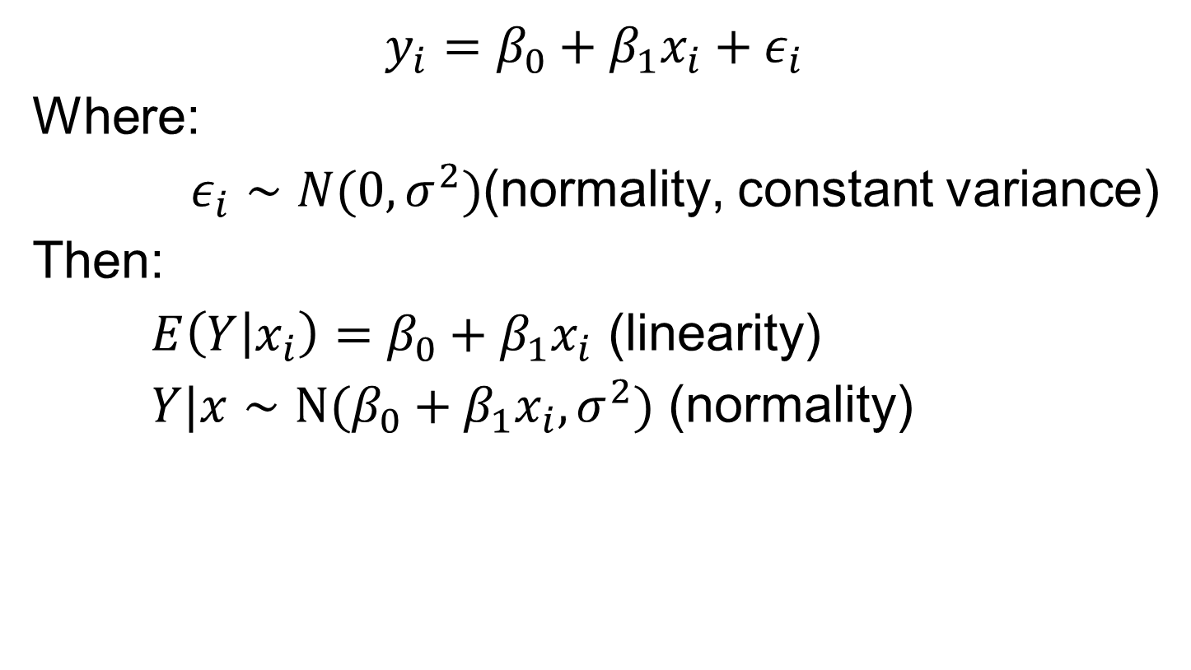
Linear regression model
$$y_{i}=β_{0}+β_{1}x_{i}+ε_{i}$$
Where:
$ε_{i}∼N(0, σ^{2})$(normality, constant variance)
Then:
$E\left(Y | x_{i}\right)=$ $β_{0}+β_{1}x_{i}$ (linearity)
$Y|x∼N(β_{0}+β_{1}x_{i}, σ^{2})$ (normality)

Slide 5

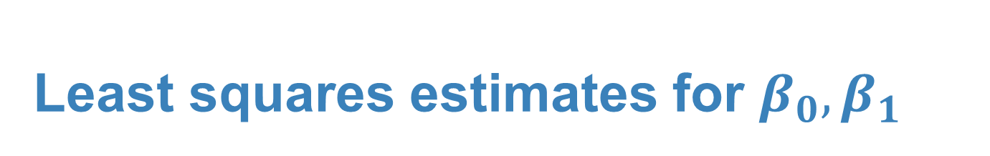
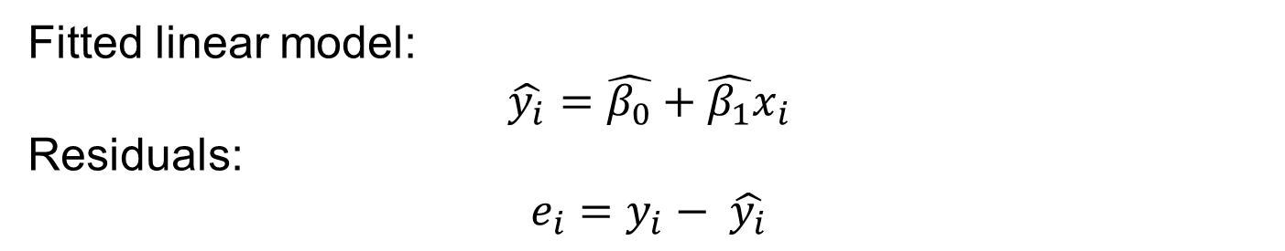
Least squares estimates for $β_{0}, β_{1}$
$$\hat{β_{0}}=\overline{y}−\hat{β_{1}} \overline{x}$$
$$\hat{β_{1}}= \frac{\sum_{i}{(x_{i}−\overline{x})(y_{i}−\overline{y})}}{\sum_{i}{{\left(x_{i}−\overline{x}\right)}^{2}}}=\frac{S_{y}}{S_{x}}R$$
Sample standard deviation of y
Correlation coefficient
Sample standard deviation of x
Fitted linear model:
$$\hat{y_{i}}=\hat{β_{0}}+\hat{β_{1}}x_{i}$$
Residuals:
$$e_{i}=y_{i}− \hat{y_{i}}$$

Slide 6
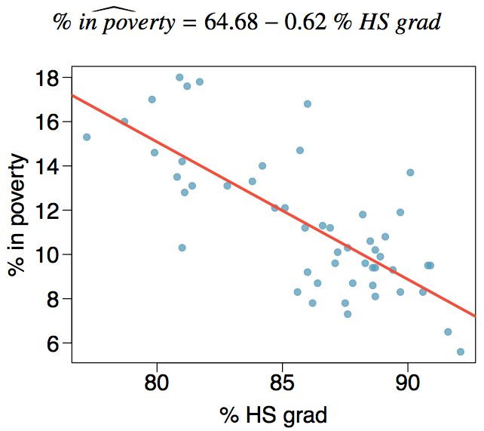
Regression line

Slide 7
Coefficient of determination

Slide 8
R²
The strength of the fit of a linear model is most commonly evaluated using R².

Slide 9
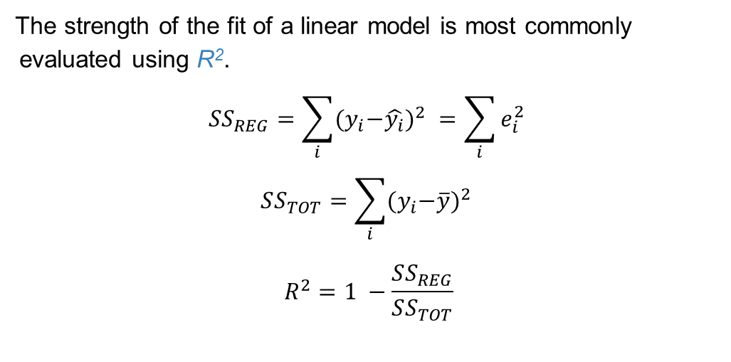
R²
The strength of the fit of a linear model is most commonly evaluated using R².
$$SS_{REG}=\sum_{i}{{{(y}_{i}−\hat{y_{i}})}^{2} }=\sum_{i}{e_{i}^{2}}$$
$$SS_{TOT}=\sum_{i}{{{(y}_{i}−\overline{y})}^{2} }$$
$$R^{2}=1 −\frac{SS_{REG}}{SS_{TOT}}$$

Slide 10
R²
The strength of the fit of a linear model is most commonly evaluated using R².
R² is calculated as the square of the correlation coefficient.

Slide 11
R²
The strength of the fit of a linear model is most commonly evaluated using R².
R² is calculated as the square of the correlation coefficient.
It tells us what percent of variance in the response variable is explained by the model.

Slide 12
R²
The strength of the fit of a linear model is most commonly evaluated using R².
R² is calculated as the square of the correlation coefficient.
It tells us what percent of variance in the response variable is explained by the model.
The remainder of the variance is explained by variables not included in the model or by inherent randomness in the data.

Slide 13
R²
The strength of the fit of a linear model is most commonly evaluated using R².
R² is calculated as the square of the correlation coefficient.
It tells us what percent of variance in the response variable is explained by the model.
The remainder of the variance is explained by variables not included in the model or by inherent randomness in the data.
For the model we've been working with, R² = -0.75² = 0.56.

Slide 14
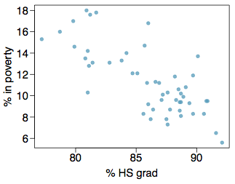
Interpretation of R²
Which of the below is the correct interpretation of R = -0.75, R² = 0.56?
56% of the variance in the % of HG graduates among the 51 states is explained by the model.
56% of the variance in the % of residents living in poverty among the 51 states is explained by the model.
56% of the time % HS graduates predict % living in poverty correctly.
75% of the variance in the % of residents living in poverty among the 51 states is explained by the model.

Slide 15
Interpretation of R²
Which of the below is the correct interpretation of R = -0.75, R² = 0.56?
56% of the variance in the % of HG graduates among the 51 states is explained by the model.
56% of the variance in the % of residents living in poverty among the 51 states is explained by the model.
56% of the time % HS graduates predict % living in poverty correctly.
75% of the variance in the % of residents living in poverty among the 51 states is explained by the model.

Slide 16
Distribution of Estimators

Slide 17
Linear regression model assumptions
$$y_{i}=β_{0}+β_{1}x_{i}+ε_{i}$$
Where:
$ε_{i}∼N(0, σ^{2})$(normality, constant variance)
Then:
$E\left(Y | x_{i}\right)=$ $β_{0}+β_{1}x_{i}$ (linearity)
$Y|x∼N(β_{0}+β_{1}x_{i}, σ^{2})$ (normality)

Slide 18
Least squares estimates for $β_{0}, β_{1}$
$$\hat{β_{0}}=\overline{y}−\hat{β_{1}} \overline{x}$$
$$\hat{β_{1}}= \frac{\sum_{i}{(x_{i}−\overline{x})(y_{i}−\overline{y})}}{\sum_{i}{{\left(x_{i}−\overline{x}\right)}^{2}}}=\frac{S_{y}}{S_{x}}R$$
Sample standard deviation of y
Correlation coefficient
Sample standard deviation of x
Under the assumptions of linear regression, these are also the MLE estimates for $β_{0},β_{1}$

Slide 19


MLE estimate for $σ^{2}$
$${\hat{σ}}^{2}= \frac{1}{n}\sum_{i}{{\left(y_{i}−\hat{β_{0}} −\hat{β_{1}}x_{i}\right)}^{2}}$$

Slide 20

Bias?
$$\hat{β_{0}}=\overline{y}−\hat{β_{1}} \overline{x}$$
$$\hat{β_{1}}= \frac{\sum_{i}{(x_{i}−\overline{x})(y_{i}−\overline{y})}}{\sum_{i}{{\left(x_{i}−\overline{x}\right)}^{2}}}$$
${\hat{σ}}^{2}= \frac{1}{n}\sum_{i}{{\left(y_{i}−\hat{β_{0}} −\hat{β_{1}}x_{i}\right)}^{2}}$

Slide 21
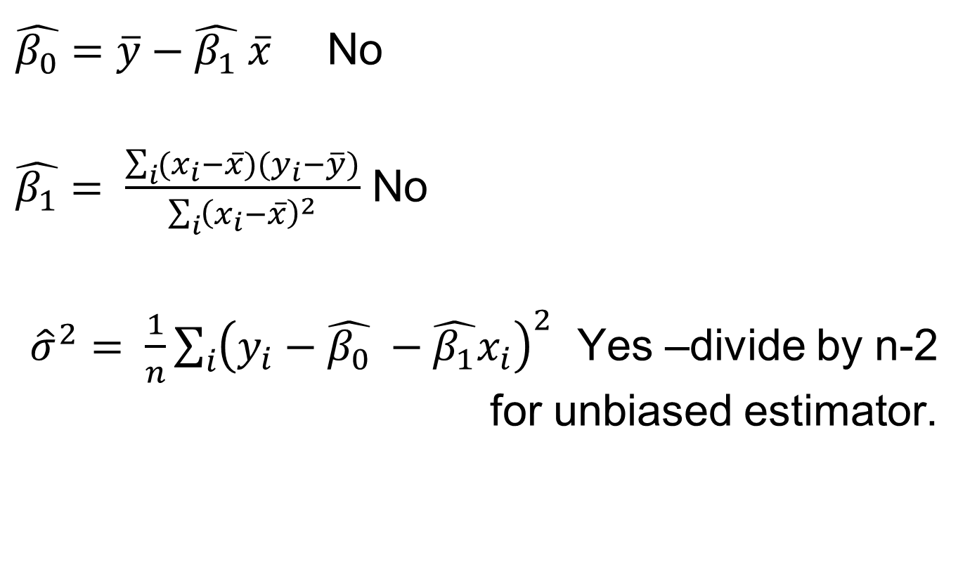
Bias?
$\hat{β_{0}}=\overline{y}−\hat{β_{1}} \overline{x}$ No
$\hat{β_{1}}= \frac{\sum_{i}{(x_{i}−\overline{x})(y_{i}−\overline{y})}}{\sum_{i}{{\left(x_{i}−\overline{x}\right)}^{2}}}$ No
${\hat{σ}}^{2}= \frac{1}{n}\sum_{i}{{\left(y_{i}−\hat{β_{0}} −\hat{β_{1}}x_{i}\right)}^{2}}$ Yes –divide by n-2 for unbiased estimator.

Slide 22
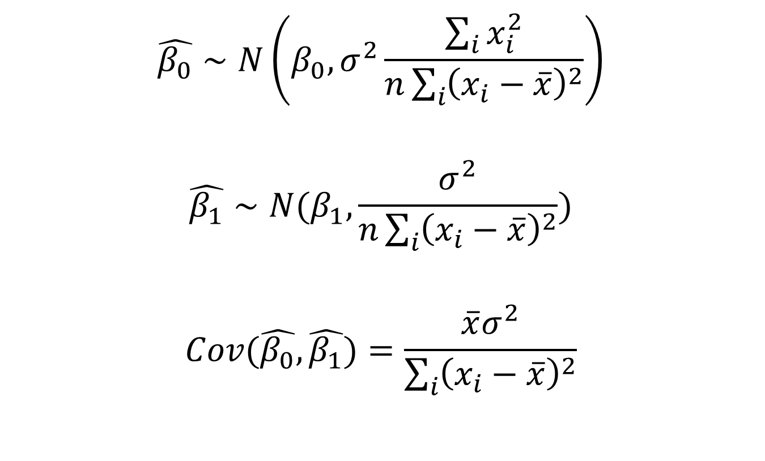
Distribution of the least squares estimators.
$$\hat{β_{0}}∼N\left(β_{0}, σ^{2}\frac{\sum_{i}{x_{i}^{2}}}{n\sum_{i}{{\left(x_{i}−\overline{x}\right)}^{2}}}\right)$$
$$\hat{β_{1}}∼N(β_{1}, \frac{σ^{2}}{n\sum_{i}{{\left(x_{i}−\overline{x}\right)}^{2}}})$$
$$Cov(\hat{β_{0}},\hat{β_{1}})=\frac{\overline{x}σ^{2}}{\sum_{i}{{\left(x_{i}−\overline{x}\right)}^{2}}}$$

Slide 23
Inference for
Linear Regression

Slide 24
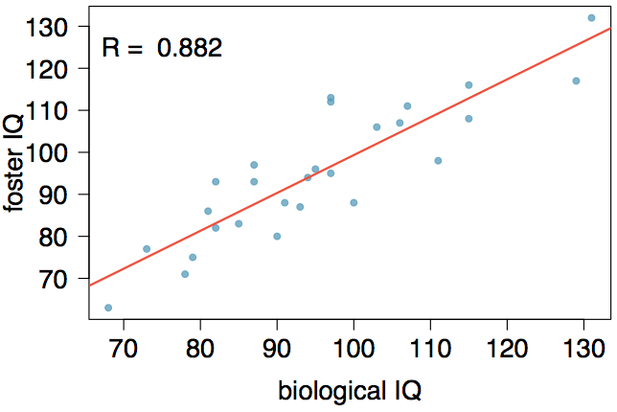
Nature or nurture?
In 1966 Cyril Burt published a paper called "The genetic determination of differences in intelligence: A study of monozygotic twins reared apart?" The data consist of IQ scores for [an assumed random sample of] 27 identical twins, one raised by foster parents, the other by the biological parents.

Slide 25
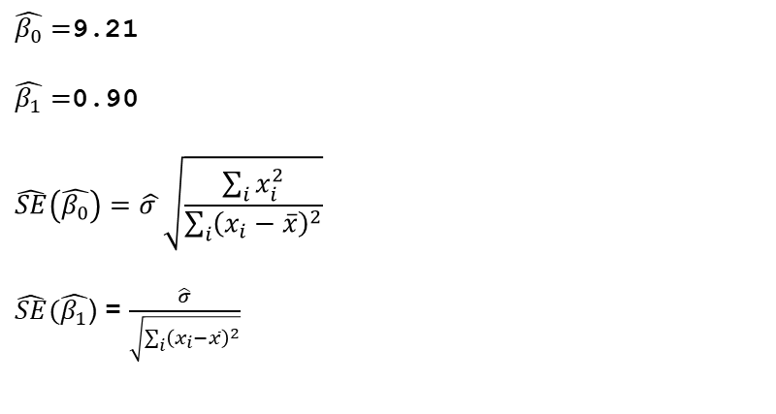
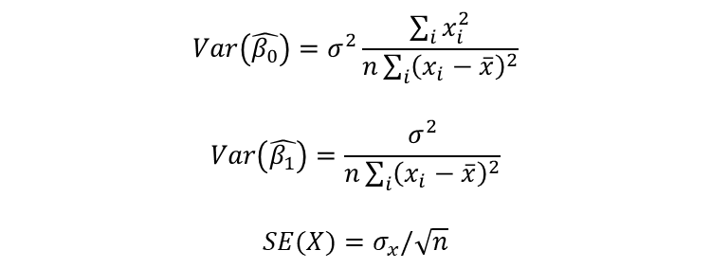
Nature or nurture?
Coefficients:
Estimate Std. Error t value Pr(>|t|)
(Intercept) 9.20760 9.29990 0.990 0.332
bioIQ 0.90144 0.09633 9.358 1.2e-09
Residual standard error: 7.729 on 25 degrees of freedom
Multiple R-squared: 0.7779, Adjusted R-squared: 0.769
F-statistic: 87.56 on 1 and 25 DF, p-value: 1.204e-09
$\hat{β_{0}}=$9.21
$\hat{β_{1}}=$0.90
$$\hat{SE}\left(\hat{β_{0}}\right)=\hat{σ }\sqrt{\frac{\sum_{i}{x_{i}^{2}}}{\sum_{i}{{\left(x_{i}−\overline{x}\right)}^{2}}}}$$
$\hat{SE}(\hat{β_{1}}\text{) =}$ $\frac{\hat{σ}}{\sqrt{\sum_{i}{{\left(x_{i}−\overline{x}\right)}^{2}}}}$
$$Var\left(\hat{β_{0}}\right)=σ^{2}\frac{\sum_{i}{x_{i}^{2}}}{n\sum_{i}{{\left(x_{i}−\overline{x}\right)}^{2}}}$$
$$Var\left(\hat{β_{1}}\right)=\frac{σ^{2}}{n\sum_{i}{{\left(x_{i}−\overline{x}\right)}^{2}}}$$
$$SE(X)=σ_{x}/\sqrt{n}$$

Slide 26

Practice
Which of the following is false?
Coefficients:
Estimate Std. Error t value Pr(>|t|)
(Intercept) 9.20760 9.29990 0.990 0.332
bioIQ 0.90144 0.09633 9.358 1.2e-09
Residual standard error: 7.729 on 25 degrees of freedom
Multiple R-squared: 0.7779, Adjusted R-squared: 0.769
F-statistic: 87.56 on 1 and 25 DF, p-value: 1.204e-09
Additional 10 points in the biological twin's IQ is associated with additional 9 points in the foster twin's IQ, on average.
Roughly 78% of the foster twins' IQs can be accurately predicted by the model.
The linear model is
Foster twins with IQs higher than average IQs tend to have biological twins with higher than average IQs as well.

Slide 27
Practice
Which of the following is false?
Coefficients:
Estimate Std. Error t value Pr(>|t|)
(Intercept) 9.20760 9.29990 0.990 0.332
bioIQ 0.90144 0.09633 9.358 1.2e-09
Residual standard error: 7.729 on 25 degrees of freedom
Multiple R-squared: 0.7779, Adjusted R-squared: 0.769
F-statistic: 87.56 on 1 and 25 DF, p-value: 1.204e-09
Additional 10 points in the biological twin's IQ is associated with additional 9 points in the foster twin's IQ, on average.
Roughly 78% of the foster twins' IQs can be accurately predicted by the model.
The linear model is
Foster twins with IQs higher than average IQs tend to have biological twins with higher than average IQs as well.

Slide 28
Testing
Assuming that these 27 twins comprise a representative sample of all twins separated at birth, we would like to test if these data provide convincing evidence that the IQ of the biological twin is a significant predictor of IQ of the foster twin. What are the appropriate hypotheses?
H₀: b₀ = 0; H_{A}: b₀ ≠ 0
H₀: β₀ = 0; H_{A}: β₀ ≠ 0
H₀: b₁ = 0; H_{A}: b₁ ≠ 0
H₀: β₁ = 0; H_{A}: β₁ ≠ 0

Slide 29
Testing for the slope
Assuming that these 27 twins comprise a representative sample of all twins separated at birth, we would like to test if these data provide convincing evidence that the IQ of the biological twin is a significant predictor of IQ of the foster twin. What are the appropriate hypotheses?
H₀: b₀ = 0; H_{A}: b₀ ≠ 0
H₀: β₀ = 0; H_{A}: β₀ ≠ 0
H₀: b₁ = 0; H_{A}: b₁ ≠ 0
H₀: β₁ = 0; H_{A}: β₁ ≠ 0

Slide 30
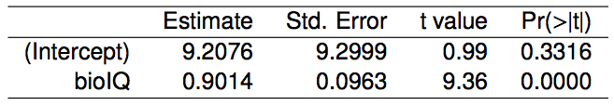
Testing for the slope (cont.)

Slide 31
Testing for the slope (cont.)
We always use a t-test in inference for regression.

Slide 32
Testing for the slope (cont.)
We always use a t-test in inference for regression.
Remember: test statistic T = (point estimate - null value) / SE

Slide 33
Testing for the slope (cont.)
We always use a t-test in inference for regression.
Remember: test statistic T = (point estimate - null value) / SE
Point estimate = b₁ is the observed slope.

Slide 34
Testing for the slope (cont.)
We always use a t-test in inference for regression.
Remember: test statistic T = (point estimate - null value) / SE
Point estimate = b₁ is the observed slope.
SE_{b1} is the standard error associated with the slope.

Slide 35
Testing for the slope (cont.)
We always use a t-test in inference for regression.
Remember: test statistic T = (point estimate - null value) / SE
Point estimate = b₁ is the observed slope.
SE_{b1} is the standard error associated with the slope.
Degrees of freedom associated with the slope is df = n - 2, where n is the sample size.

Slide 36
Testing for the slope (cont.)
We always use a t-test in inference for regression.
Remember: test statistic T = (point estimate - null value) / SE
Point estimate = b₁ is the observed slope.
SE_{b1} is the standard error associated with the slope.
Degrees of freedom associated with the slope is df = n - 2, where n is the sample size.
Remember: we lose 1 degree of freedom for each parameter we estimate, and in simple linear regression we estimate 2 parameters, β₀ and β₁.

Slide 37
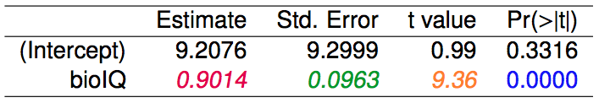
Testing for the slope (cont.)

Slide 38

Testing for the slope (cont.)

Slide 39
Testing for the slope (cont.)

Slide 40

Testing for the slope (cont.)

Slide 41
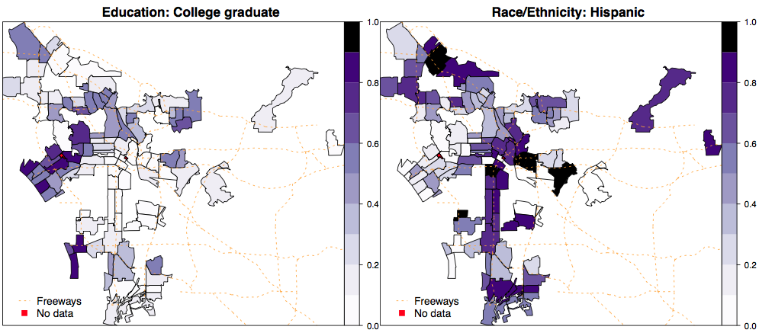
Percent college graduate vs. percent Hispanic in LA
What can you say about the relationship between % college graduate and % Hispanic in a sample of 100 zip code areas in LA?

Slide 42
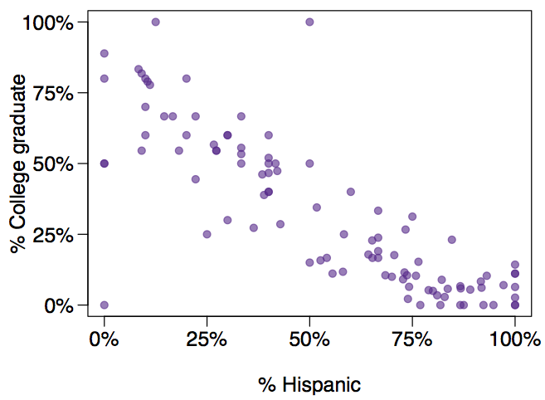
% college educated vs. % Hispanic in LA, another look
What can you say about the relationship between of % college graduate and % Hispanic in a sample of 100 zip code areas in LA?

Slide 43
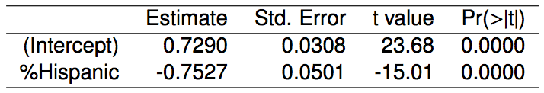
% college educated vs. % Hispanic in LA - linear model
Which of the below is the best interpretation of the slope?
A 1% increase in Hispanic residents in a zip code area in LA is associated with a 75% decrease in % of college grads.
A 1% increase in Hispanic residents in a zip code area in LA is associated with a 0.75% decrease in % of college grads.
An additional 1% of Hispanic residents decreases the % of college graduates in a zip code area in LA by 0.75%.
In zip code areas with no Hispanic residents, % of college graduates is expected to be 75%.

Slide 44
% college educated vs. % Hispanic in LA - linear model
Which of the below is the best interpretation of the slope?
A 1% increase in Hispanic residents in a zip code area in LA is associated with a 75% decrease in % of college grads.
A 1% increase in Hispanic residents in a zip code area in LA is associated with a 0.75% decrease in % of college grads.
An additional 1% of Hispanic residents decreases the % of college graduates in a zip code area in LA by 0.75%.
In zip code areas with no Hispanic residents, % of college graduates is expected to be 75%.

Slide 45
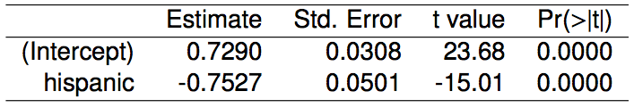
% college educated vs. % Hispanic in LA - linear model
Do these data provide convincing evidence that there is a statistically significant relationship between % Hispanic and % college graduates in zip code areas in LA?
How reliable is this p-value if these zip code areas are not randomly selected?

Slide 46
% college educated vs. % Hispanic in LA - linear model
Do these data provide convincing evidence that there is a statistically significant relationship between % Hispanic and % college graduates in zip code areas in LA?
Yes, the p-value for % Hispanic is low, indicating that the data provide convincing evidence that the slope parameter is different than 0.
How reliable is this p-value if these zip code areas are not randomly selected?

Slide 47
% college educated vs. % Hispanic in LA - linear model
Do these data provide convincing evidence that there is a statistically significant relationship between % Hispanic and % college graduates in zip code areas in LA?
Yes, the p-value for % Hispanic is low, indicating that the data provide convincing evidence that the slope parameter is different than 0.
How reliable is this p-value if these zip code areas are not randomly selected?
Not very...

Slide 48
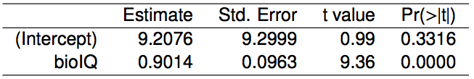
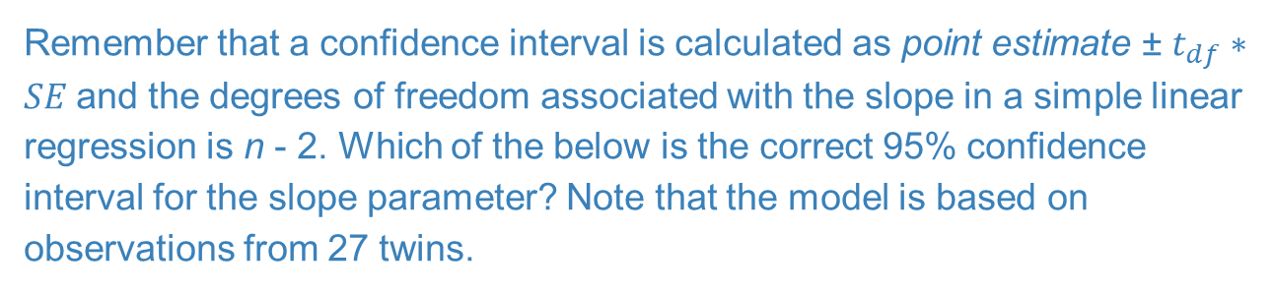
Confidence interval for the slope
Remember that a confidence interval is calculated as point estimate ± $t_{df}∗SE$and the degrees of freedom associated with the slope in a simple linear regression is n - 2. Which of the below is the correct 95% confidence interval for the slope parameter? Note that the model is based on observations from 27 twins.
9.2076 ± 1.65 x 9.2999
0.9014 ± 2.06 x 0.0963
0.9014 ± 1.96 x 0.0963
9.2076 ± 1.96 x 0.0963

Slide 49
Confidence interval for the slope
Remember that a confidence interval is calculated as point estimate ± $t_{df}∗SE$and the degrees of freedom associated with the slope in a simple linear regression is n - 2. Which of the below is the correct 95% confidence interval for the slope parameter? Note that the model is based on observations from 27 twins.
9.2076 ± 1.65 x 9.2999
0.9014 ± 2.06 x 0.0963
0.9014 ± 1.96 x 0.0963
9.2076 ± 1.96 x 0.0963
n = 27 df = 27 - 2 = 25
For a $γ−$ confidence interval we look at (1+$γ$)/2 T-quantile

Slide 50
Confidence interval for the slope
Remember that a confidence interval is calculated as point estimate ± ME and the degrees of freedom associated with the slope in a simple linear regression is n - 2. Which of the below is the correct 95% confidence interval for the slope parameter? Note that the model is based on observations from 27 twins.
n = 27 df = 27 - 2 = 25
9.2076 ± 1.65 x 9.2999
0.9014 ± 2.06 x 0.0963
0.9014 ± 1.96 x 0.0963
9.2076 ± 1.96 x 0.0963
95%: t₂₅* = 2.06
0.9014 ± 2.06 x 0.0963

Slide 51
Confidence interval for the slope
Remember that a confidence interval is calculated as point estimate ± ME and the degrees of freedom associated with the slope in a simple linear regression is n - 2. Which of the below is the correct 95% confidence interval for the slope parameter? Note that the model is based on observations from 27 twins.
n = 27 df = 27 - 2 = 25
9.2076 ± 1.65 x 9.2999
0.9014 ± 2.06 x 0.0963
0.9014 ± 1.96 x 0.0963
9.2076 ± 1.96 x 0.0963
95%: t₂₅* = 2.06
0.9014 ± 2.06 x 0.0963
(0.7, 1.1)

Slide 52
Recap
Inference for the slope for a single-predictor linear regression model:

Slide 53

Recap
Inference for the slope for a single-predictor linear regression model:
Hypothesis test:

Slide 54

Recap
Inference for the slope for a single-predictor linear regression model:
Hypothesis test:
Confidence interval:

Slide 55
Recap
Inference for the slope for a single-predictor linear regression model:
Hypothesis test:
Confidence interval:
The null value is often 0 since we are usually checking for any relationship between the explanatory and the response variable.

Slide 56
Recap
Inference for the slope for a single-predictor linear regression model:
Hypothesis test:
Confidence interval:
The null value is often 0 since we are usually checking for any relationship between the explanatory and the response variable.
The regression output gives b₁, SE_{b1}, and two-tailed p-value for the t-test for the slope where the null value is 0.

Slide 57
Recap
Inference for the slope for a single-predictor linear regression model:
Hypothesis test:
Confidence interval:
The null value is often 0 since we are usually checking for any relationship between the explanatory and the response variable.
The regression output gives b₁, SE_{b1}, and two-tailed p-value for the t-test for the slope where the null value is 0.
We rarely do inference on the intercept, so we'll be focusing on the estimates and inference for the slope.

Slide 58
