Slide 1
Linear Regression

Slide 2
Correlation and Covariance
Son’s height
Son’s height
Father’s income
Father’s height

Slide 3
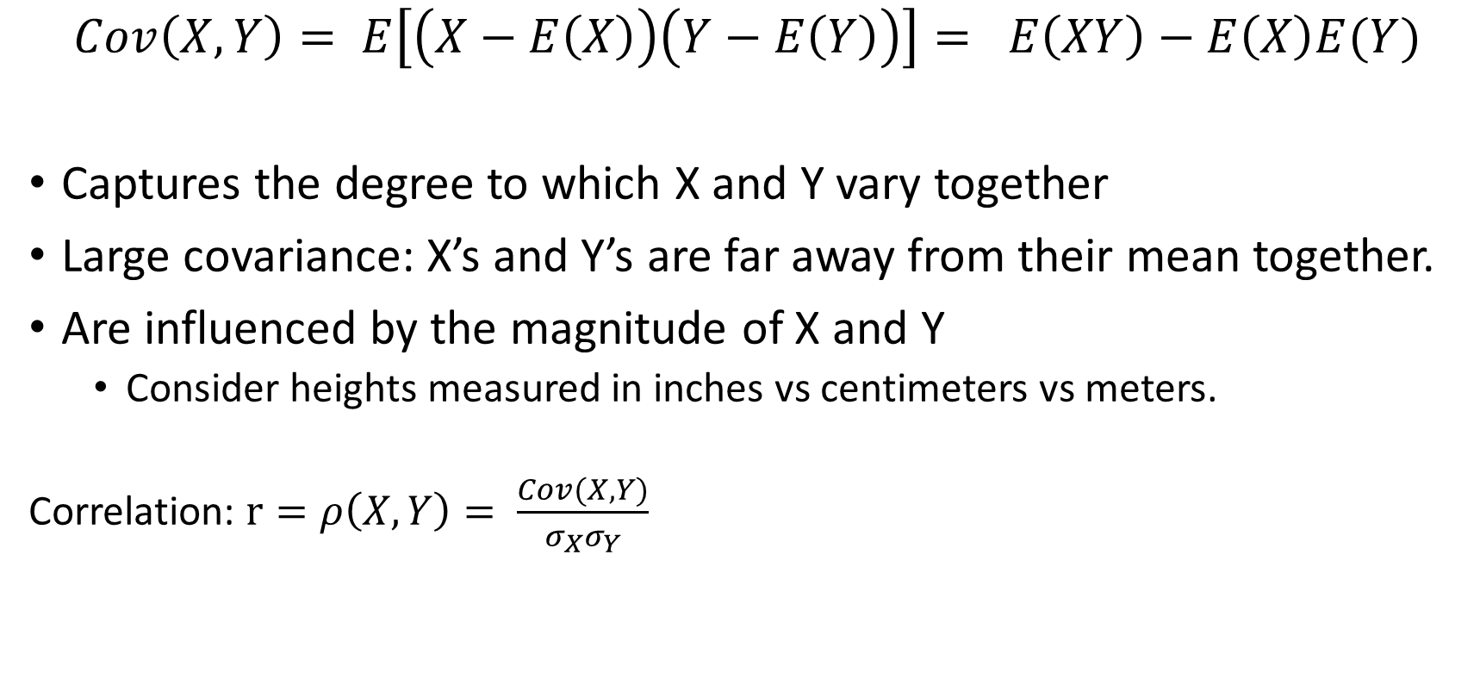
Covariance and correlation
$$Cov\left(X, Y\right)= E\left[\left(X−E\left(X\right)\right)\left(Y−E\left(Y\right)\right)\right]= E\left(XY\right)−E\left(X\right)E(Y)$$
Captures the degree to which X and Y vary together
Large covariance: X’s and Y’s are far away from their mean together.
Are influenced by the magnitude of X and Y
  Consider heights measured in inches vs centimeters vs meters.
  Correlation: $r=ρ\left(X, Y\right)= \frac{Cov(X, Y)}{σ_{X}σ_{Y}}$

Slide 4
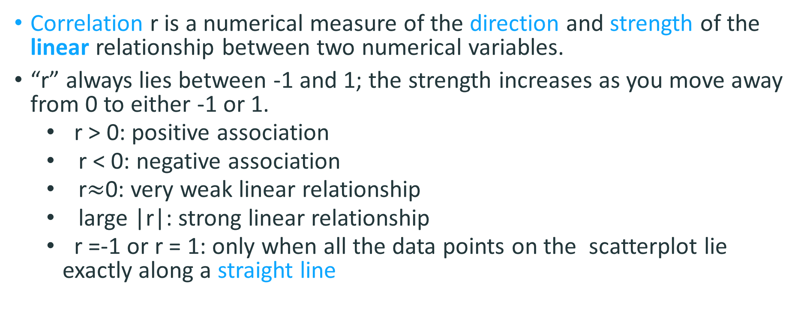
Correlation
Correlation r is a numerical measure of the direction and strength of the linear relationship between two numerical variables.
“r” always lies between -1 and 1; the strength increases as you move away from 0 to either -1 or 1.
  r > 0: positive association
  r < 0: negative association
  r$≈$0: very weak linear relationship
  large |r|: strong linear relationship
  r =-1 or r = 1: only when all the data points on the scatterplot lie exactly along a straight line

Slide 5
Positive Correlations

Slide 6
Negative Correlations

Slide 7
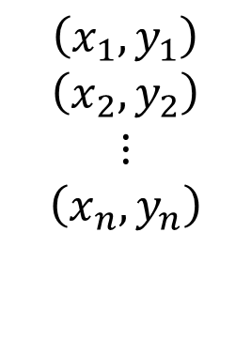
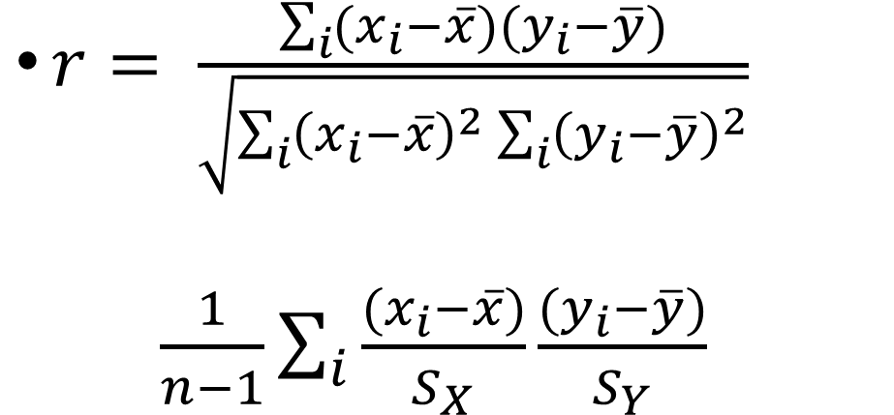
Correlation Coefficient
$r= \frac{\sum_{i}{(x_{i}−\overline{x})(y_{i}−\overline{y})}}{\sqrt{\sum_{i}{{\left(x_{i}−\overline{x}\right)}^{2}}\sum_{i}{{\left(y_{i}−\overline{y}\right)}^{2}}}}$
$\frac{1}{n−1}\sum_{i}{\frac{(x_{i}−\overline{x})}{S_{X}}\frac{{(y}_{i}−\overline{y})}{S_{Y}}}$
$$\left(x_{1},y_{1}\right)$$
$$\left(x_{2},y_{2}\right)$$
$$⋮$$
$$\left(x_{n},y_{n}\right)$$
Z-score of X
Z-score of Y

Slide 8

What is the sign of
Here r > 0;
more positive
contributions than
negative.
What kind of points
have large
contributions to the
correlation?
$$\frac{(x_{i}−\overline{x})}{S_{X}}\frac{{(y}_{i}−\overline{y})}{S_{Y}}$$

Slide 9
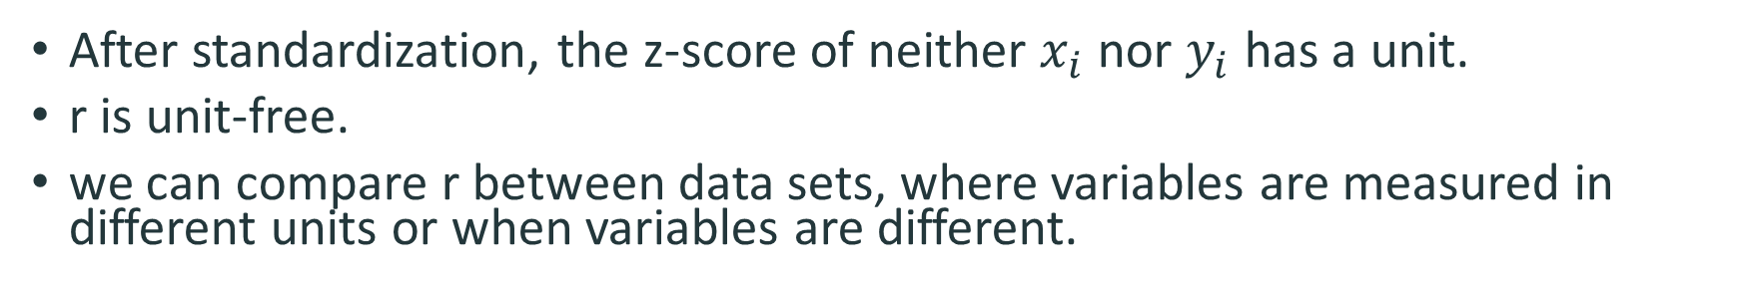
Correlation has no unit
After standardization, the z-score of neither $x_{i}$ nor $y_{i}$ has a unit.
r is unit-free.
we can compare r between data sets, where variables are measured in different units or when variables are different.

Slide 10
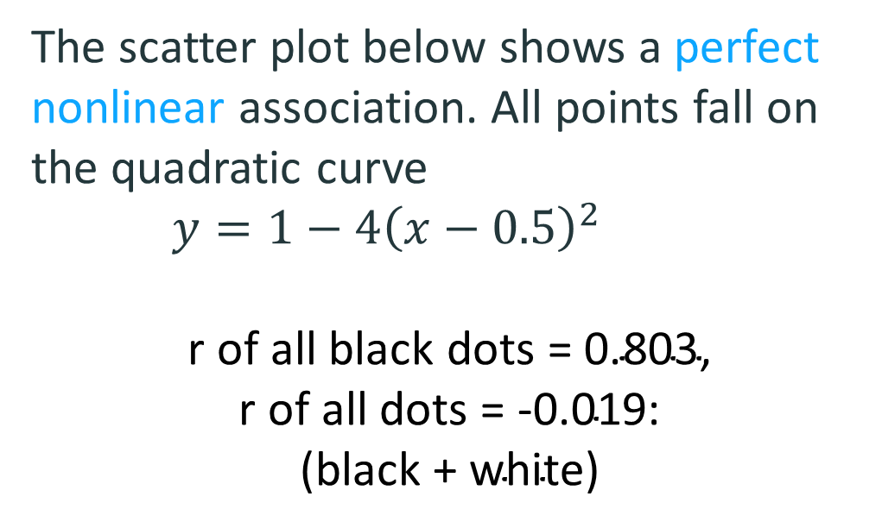
Correlation only measures linear dependence
The scatter plot below shows a perfect nonlinear association. All points fall on the quadratic curve
$y=1−4{\left(x−0.5\right)}^{2}$
$$\text{r} \text{of} \text{all} \text{black} \text{dots}\text{ = }\text{0}\text{.}\text{803}\text{,}$$
$$\text{r} \text{of} \text{all} \text{dots}\text{ = }\text{−}\text{0}\text{.}\text{019}\text{:}$$
$$\text{(}\text{black}\text{ + }\text{white}\text{)}$$

Slide 11
Correlation can be misleading
In all these data sets, r =0.82!

Slide 12
Correlation can be misleading

Slide 13
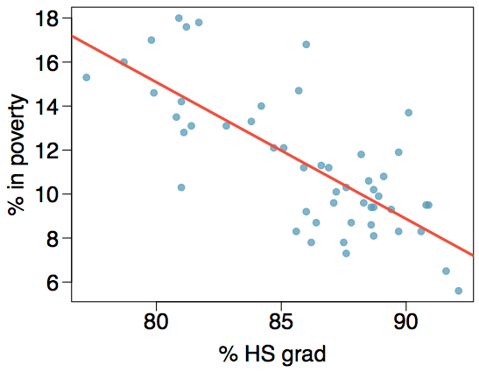
Poverty vs. HS graduate rate
The scatterplot below shows the relationship between HS graduate rate in all 50 US states and DC and the percent of residents who live below the poverty line
(income below $23,050 for a family of 4 in 2012).

Slide 14
Guessing the correlation
Which of the following is the best guess for the correlation between percent in poverty and percent HS grad?
0.6
-0.75
-0.1
0.02
-1.5

Slide 15
Guessing the correlation
Which of the following is the best guess for the correlation between percent in poverty and percent HS grad?
0.6
-0.75
-0.1
0.02
-1.5

Slide 16
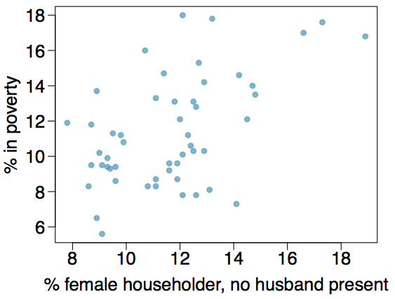
Guessing the correlation
Which of the following is the best guess for the correlation between percent in poverty and percent female householder?
0.1
-0.6
-0.4
0.9
0.5

Slide 17
Guessing the correlation
Which of the following is the best guess for the correlation between percent in poverty and percent female householder?
0.1
-0.6
-0.4
0.9
0.5

Slide 18
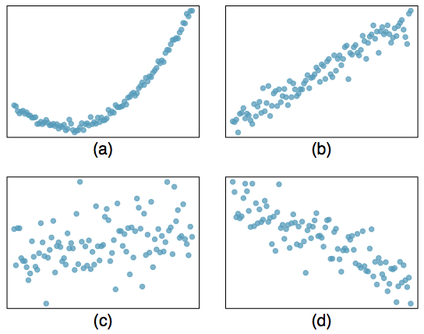
Assessing the correlation
Which of the following is has the strongest correlation, i.e. correlation coefficient closest to +1 or -1?

Slide 19
Assessing the correlation
Which of the following is has the strongest correlation, i.e. correlation coefficient closest to +1 or -1?
(b) → correlation means linear association

Slide 20
Line Fitting and
Residuals

Slide 21
^{Predicting a numeric variable}
Correlation is symmetric: corr(X,Y) = corr(Y, X)
In this unit we will learn to model numerical response variables using a numerical or categorical explanatory variable.

Slide 22
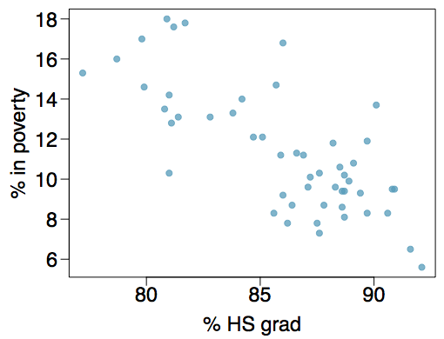
Poverty vs. HS graduate rate
The scatterplot below shows the relationship between HS graduate rate in all 50 US states and DC and the percent of residents who live below the poverty line
(income below $23,050 for a family of 4 in 2012).
Response variable?

Slide 23
Poverty vs. HS graduate rate
The scatterplot below shows the relationship between HS graduate rate in all 50 US states and DC and the percent of residents who live below the poverty line
(income below $23,050 for a family of 4 in 2012).
Response variable?
% in poverty

Slide 24
Poverty vs. HS graduate rate
The scatterplot below shows the relationship between HS graduate rate in all 50 US states and DC and the percent of residents who live below the poverty line
(income below $23,050 for a family of 4 in 2012).
Response variable?
% in poverty
Explanatory variable?

Slide 25
Poverty vs. HS graduate rate
The scatterplot below shows the relationship between HS graduate rate in all 50 US states and DC and the percent of residents who live below the poverty line
(income below $23,050 for a family of 4 in 2012).
Response variable?
% in poverty
Explanatory variable?
% HS grad

Slide 26
Poverty vs. HS graduate rate
The scatterplot below shows the relationship between HS graduate rate in all 50 US states and DC and the percent of residents who live below the poverty line
(income below $23,050 for a family of 4 in 2012).
Response variable?
% in poverty
Explanatory variable?
% HS grad
Relationship?

Slide 27
Poverty vs. HS graduate rate
The scatterplot below shows the relationship between HS graduate rate in all 50 US states and DC and the percent of residents who live below the poverty line
(income below $23,050 for a family of 4 in 2012).
Response variable?
% in poverty
Explanatory variable?
% HS grad
Relationship?
linear

Slide 28
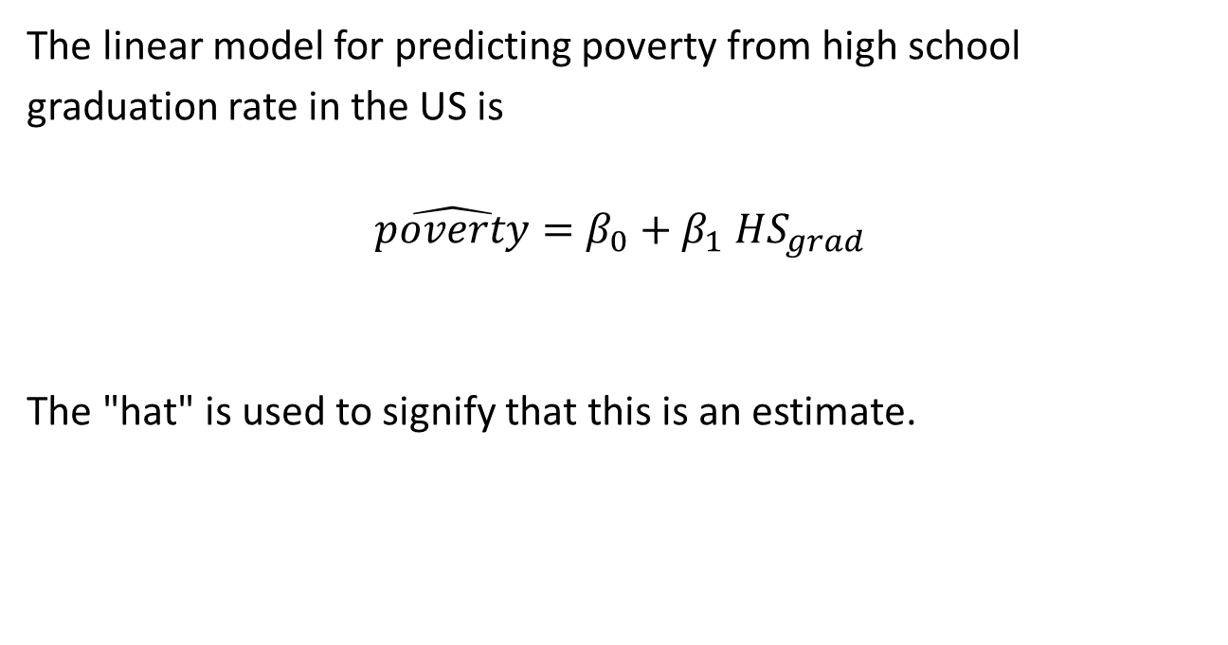
Poverty vs. HS graduate rate
The linear model for predicting poverty from high school graduation rate in the US is
$$\hat{poverty}=β_{0}+β_{1} HS_{grad}$$
The "hat" is used to signify that this is an estimate.

Slide 29

Poverty vs. HS graduate rate
The linear model for predicting poverty from high school graduation rate in the US is
The "hat" is used to signify that this is an estimate.
The high school graduate rate in Georgia is 85.1%. What poverty level does the model predict for this state?
64.78 − 0.62 x 85.1 = 12.018

Slide 30
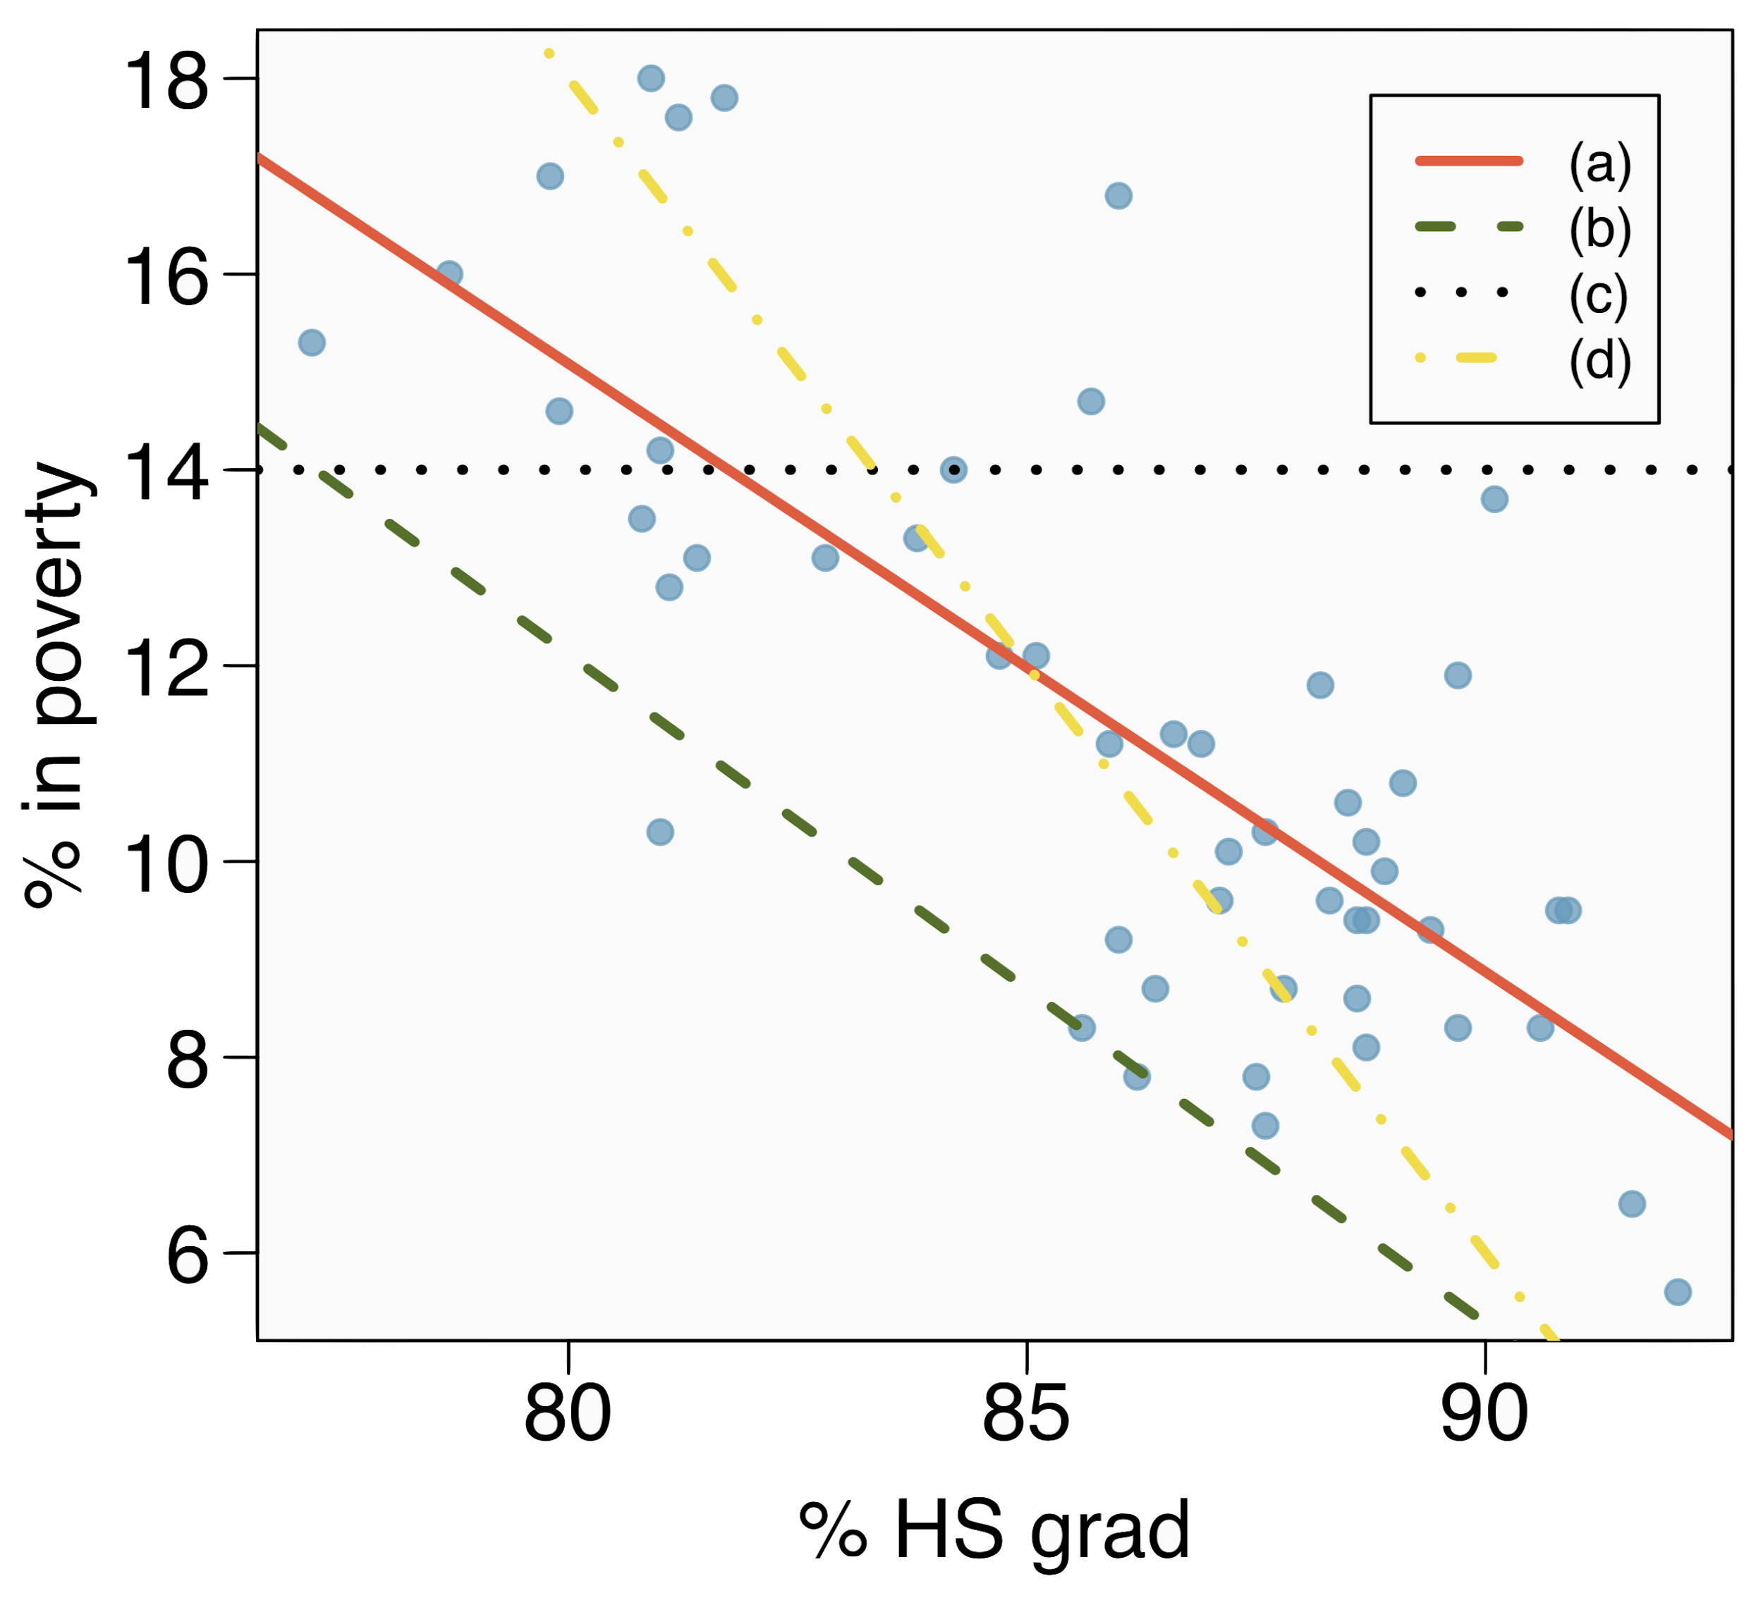
Eyeballing the line
Which of the following appears to be the line that best fits the linear relationship between % in poverty and % HS grad? Choose one.

Slide 31
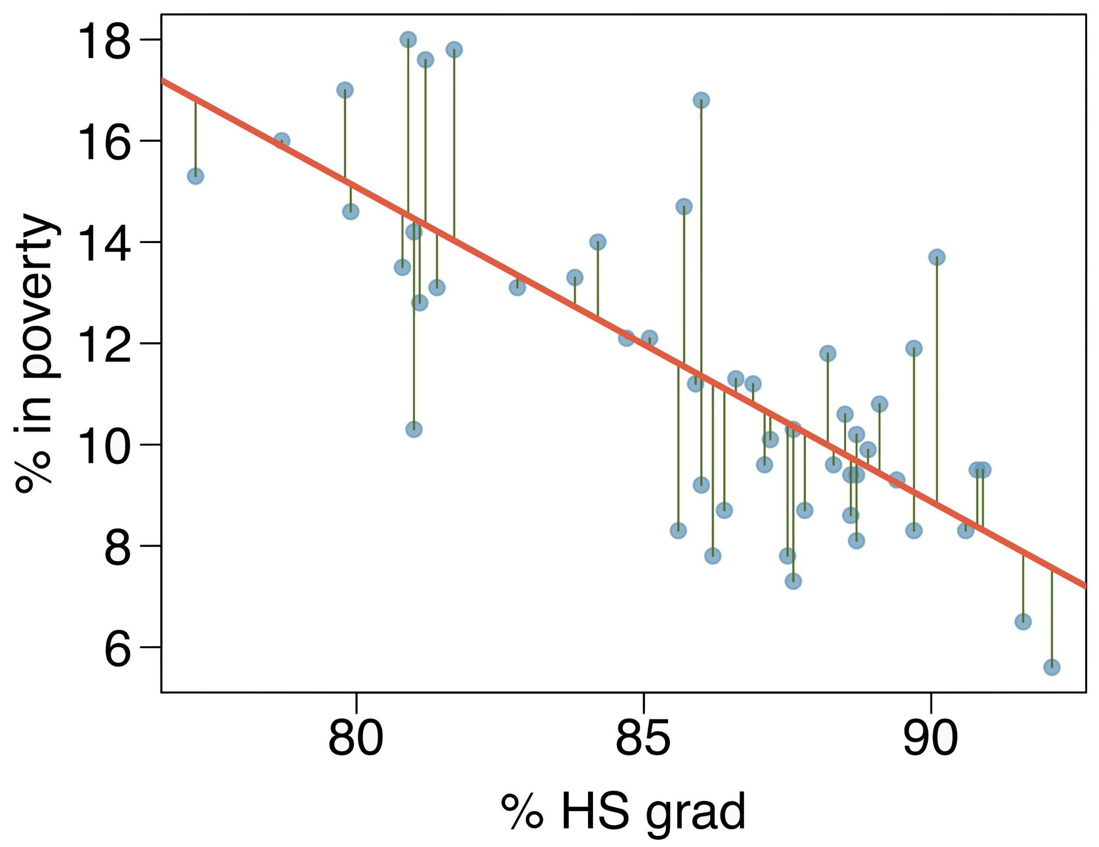
Residuals
Residuals are the leftovers from the model fit:
Data = Fit + Residual

Slide 32
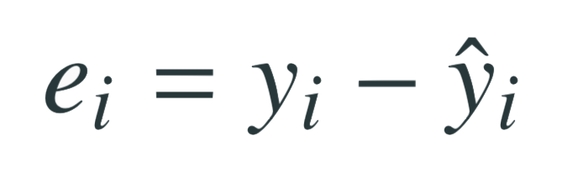
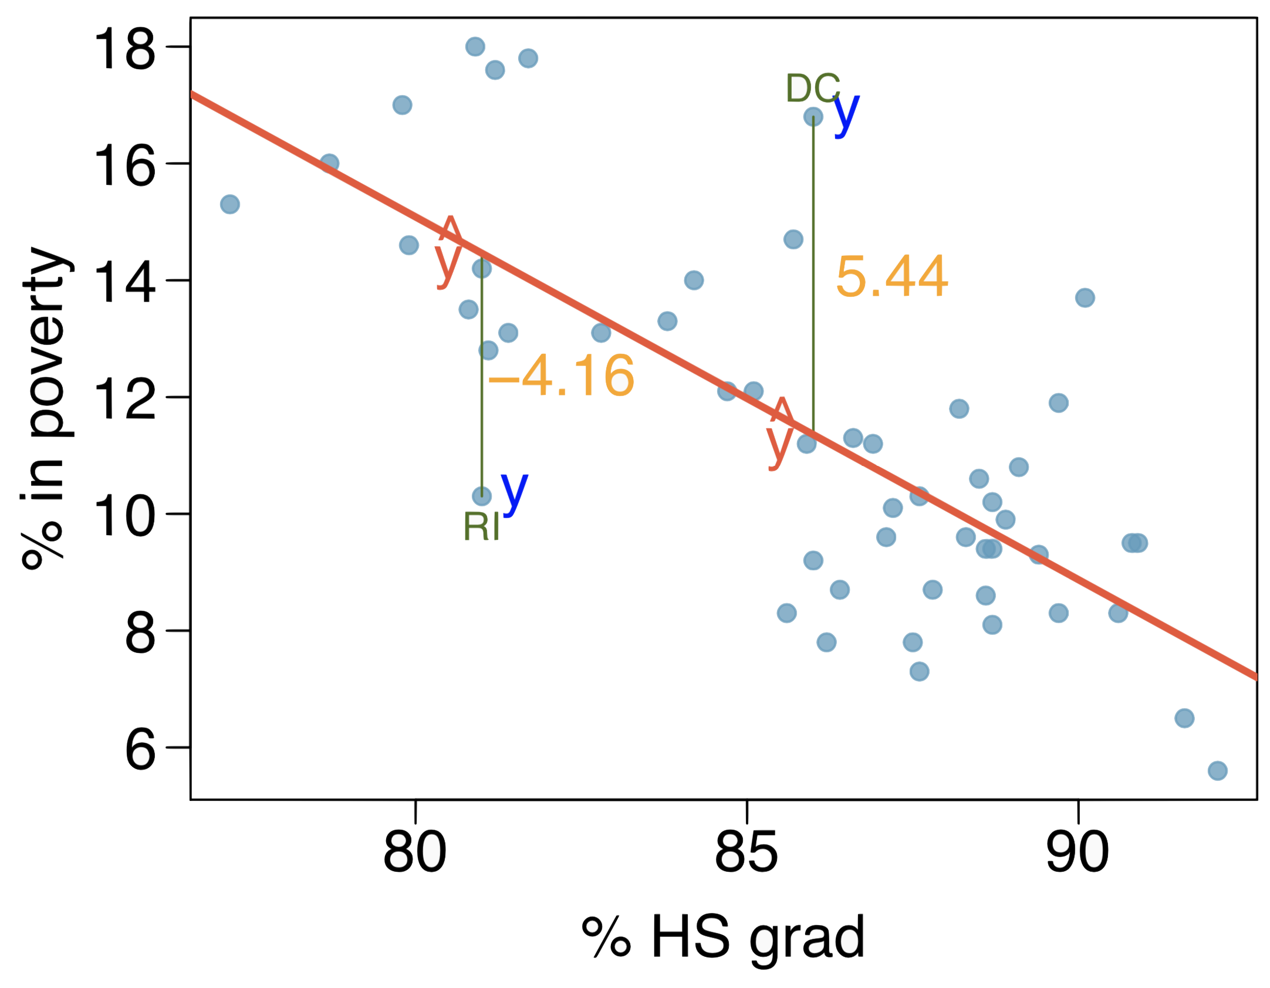
Residuals (cont.)
Residual is the difference between the observed (y_{i}) and predicted ŷ_{i}.

Slide 33
Residuals (cont.)
Residual is the difference between the observed (y_{i}) and predicted ŷ_{i}.
% living in poverty in DC is 5.44% more than predicted.

Slide 34
Residuals (cont.)
Residual is the difference between the observed (y_{i}) and predicted ŷ_{i}.
% living in poverty in DC is 5.44% more than predicted.
% living in poverty in RI is 4.16% less than predicted.

Slide 35
Fitting a line by least squares regression

Slide 36
A measure for the best line
We want a line that has small residuals

Slide 37
A measure for the best line
We want a line that has small residuals
Option 1: Minimize the sum of magnitudes (absolute values) of residuals
|e₁| + |e₂| + … + |e_{n}|

Slide 38
A measure for the best line
We want a line that has small residuals
Option 1: Minimize the sum of magnitudes (absolute values) of residuals
|e₁| + |e₂| + … + |e_{n}|
Option 2: Minimize the sum of squared residuals -- least squares
e₁² + e₂² + … + e_{n}²

Slide 39
A measure for the best line
We want a line that has small residuals
Option 1: Minimize the sum of magnitudes (absolute values) of residuals
|e₁| + |e₂| + … + |e_{n}|
Option 2: Minimize the sum of squared residuals -- least squares
e₁² + e₂² + … + e_{n}²
Why least squares?

Slide 40
A measure for the best line
We want a line that has small residuals
Option 1: Minimize the sum of magnitudes (absolute values) of residuals
|e₁| + |e₂| + … + |e_{n}|
Option 2: Minimize the sum of squared residuals -- least squares
e₁² + e₂² + … + e_{n}²
Why least squares?
Most commonly used

Slide 41
A measure for the best line
We want a line that has small residuals
Option 1: Minimize the sum of magnitudes (absolute values) of residuals
|e₁| + |e₂| + … + |e_{n}|
Option 2: Minimize the sum of squared residuals -- least squares
e₁² + e₂² + … + e_{n}²
Why least squares?
Most commonly used
Easier to compute by hand and using software

Slide 42
A measure for the best line
We want a line that has small residuals
Option 1: Minimize the sum of magnitudes (absolute values) of residuals
|e₁| + |e₂| + … + |e_{n}|
Option 2: Minimize the sum of squared residuals -- least squares
e₁² + e₂² + … + e_{n}²
Why least squares?
Most commonly used
Easier to compute by hand and using software
In many applications, a residual twice as large as another is usually more than twice as bad

Slide 43
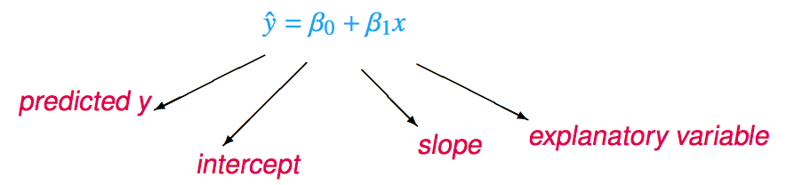
The least squares line
Notation:
Intercept:
Parameter: β₀
Point estimate: b₀
Slope:
Parameter: β₁
Point estimate: b₁

Slide 44
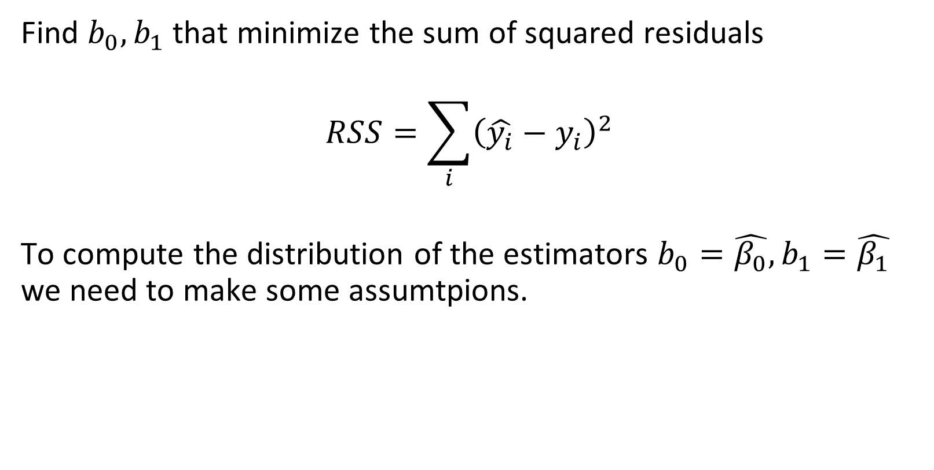
Finding the least squares line
Find $b_{0}, b_{1}$ that minimize the sum of squared residuals
$$RSS=\sum_{i}{{\left(\hat{y_{i}}−y_{i}\right)}^{2}}$$
To compute the distribution of the estimators $b_{0}=\hat{β_{0}},b_{1}=\hat{β_{1}}$ we need to make some assumtpions.

Slide 45
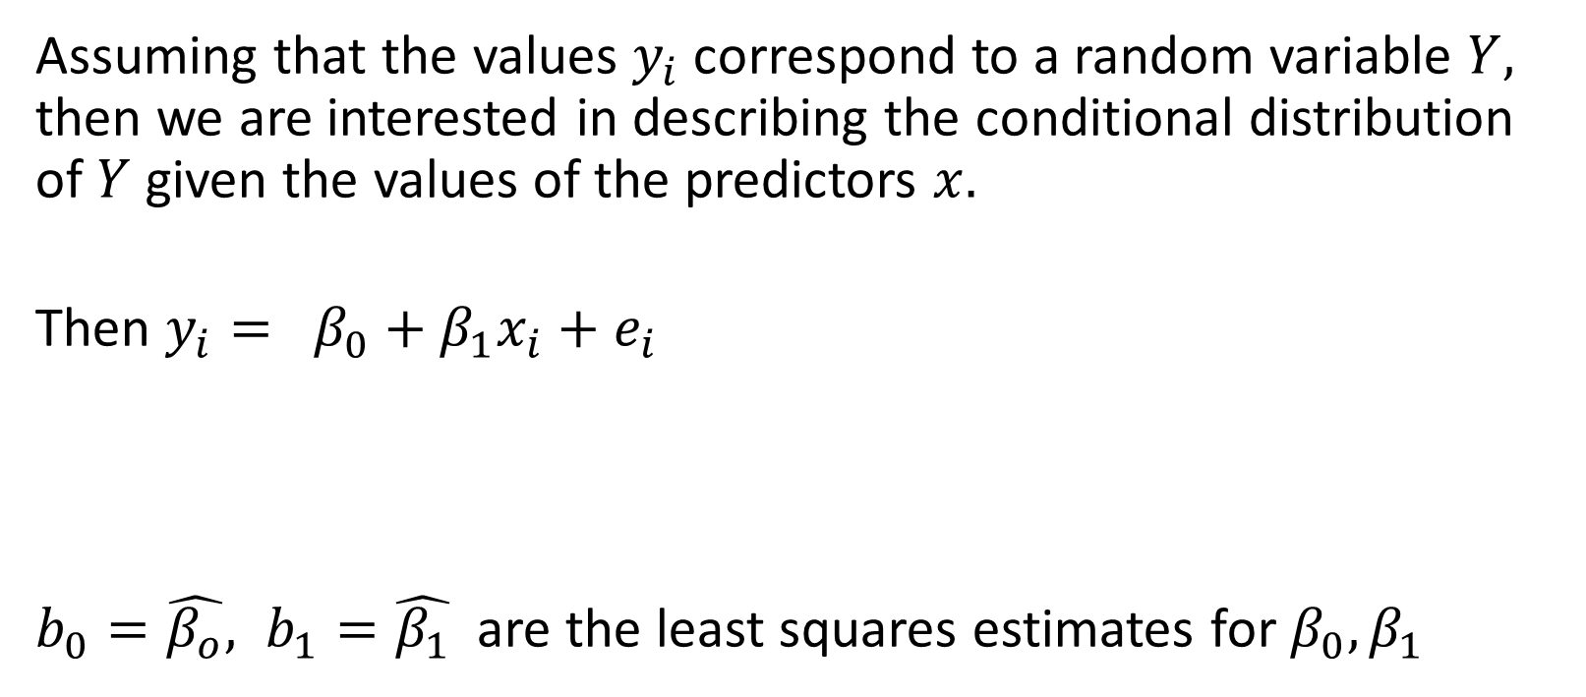
Regression line
Assuming that the values $y_{i}$ correspond to a random variable $Y,$ then we are interested in describing the conditional distribution of $Y$ given the values of the predictors $x.$
Then $y_{i}= β_{0}+β_{1}x_{i}+e_{i}$
$b_{0}=\hat{β_{o}}, b_{1}=\hat{β_{1}}$ are the least squares estimates for $β_{0}, β_{1}$
$$E\left(Y | x\right)=β_{0}+β_{1}x$$

Slide 46
Conditions for the least squares line
Linearity

Slide 47
Conditions for the least squares line
Linearity
Normality

Slide 48
Conditions for the least squares line
Linearity
Normality
Constant variance (homoskedasticity)

Slide 49
Conditions for the least squares line
Linearity
Normality
Constant variance (homoskedasticity)
Independence

Slide 50

Conditions: (1) Linearity
The relationship between the explanatory and the response variable should be linear.
There exist parameters $β_{0}, β_{1}$ such that $E\left(Y_{i} | x_{i}\right) =$ $β_{0}+β_{1}x_{i}$

Slide 51
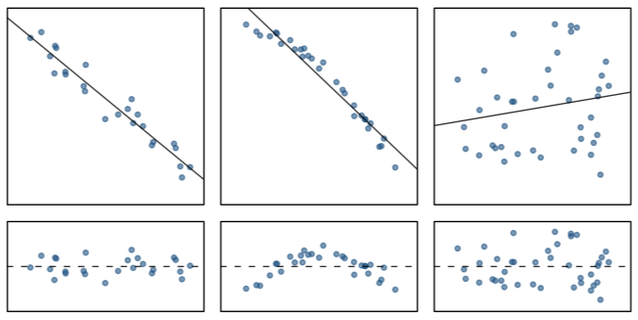

Conditions: (1) Linearity
The relationship between the explanatory and the response variable should be linear.
There exist parameters $β_{0}, β_{1}$ such that $E\left(Y_{i} | x_{i}\right) =$ $β_{0},+β_{1}x_{i}$
Check using a scatterplot of the data, or a residuals plot.

Slide 52
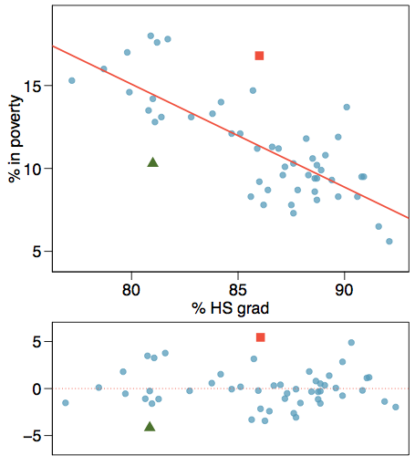
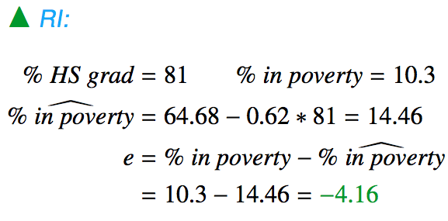
Anatomy of a residuals plot

Slide 53
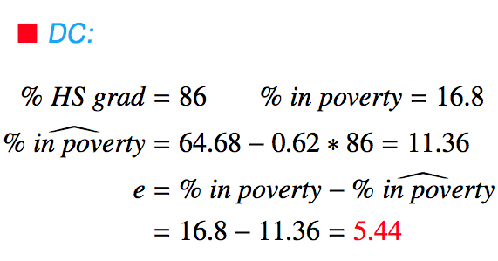
Anatomy of a residuals plot

Slide 54

Conditions: (2) Normality
For $i=1, …, n$ the conditional distribution of $Y_{i}$ given $x_{i}$ is a normal distribution.
The residuals should be nearly normal.
This condition may not be satisfied when there are unusual observations that don't follow the trend of the rest of the data.

Slide 55
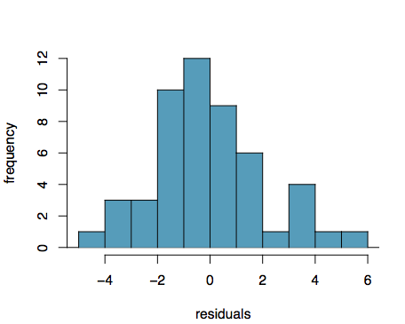

Conditions: (2) Normality
For $i=1, …, n$ the conditional distribution of $Y_{i}$ given $x_{i}$ is a normal distribution.
The residuals should be nearly normal.
This condition may not be satisfied when there are unusual observations that don't follow the trend of the rest of the data.
Check using a histogram or normal probability plot of residuals.

Slide 56
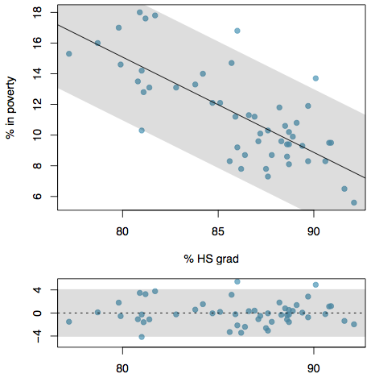
Conditions: (3) Constant variance
The variance of points around the least squares line should be roughly constant.

Slide 57
Conditions: (3) Constant variance
The variance of points around the least squares line should be roughly constant.
This implies that the variance of residuals around the 0 line should be roughly constant as well.

Slide 58
Conditions: (3) Constant variance
The variance of points around the least squares line should be roughly constant.
This implies that the variance of residuals around the 0 line should be roughly constant as well.
Also called homoscedasticity.

Slide 59
Conditions: (3) Constant variance
The variance of points around the least squares line should be roughly constant.
This implies that the variance of residuals around the 0 line should be roughly constant as well.
Also called homoscedasticity.
Check using a histogram or normal probability plot of residuals.

Slide 60
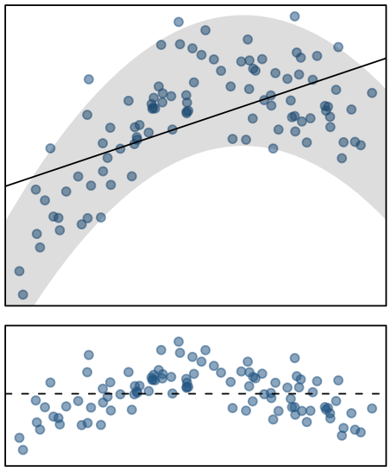
Checking conditions
What condition is this linear model obviously violating?
Constant variance
Linear relationship
Normal residuals
No extreme outliers

Slide 61
Checking conditions
What condition is this linear model obviously violating?
Constant variance
Linear relationship
Normal residuals
No extreme outliers

Slide 62
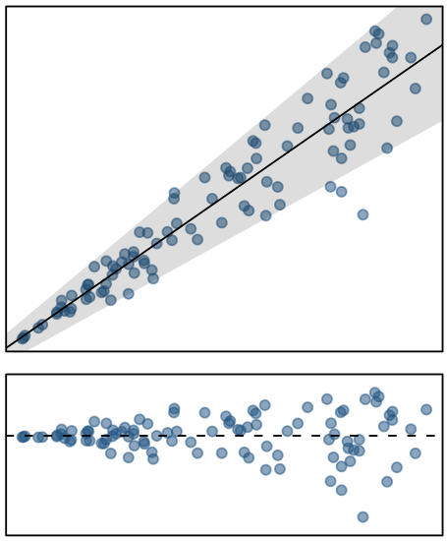
Checking conditions
What condition is this linear model obviously violating?
Constant variance
Linear relationship
Normal residuals
No extreme outliers

Slide 63
Checking conditions
What condition is this linear model obviously violating?
Constant variance
Linear relationship
Normal residuals
No extreme outliers

Slide 64
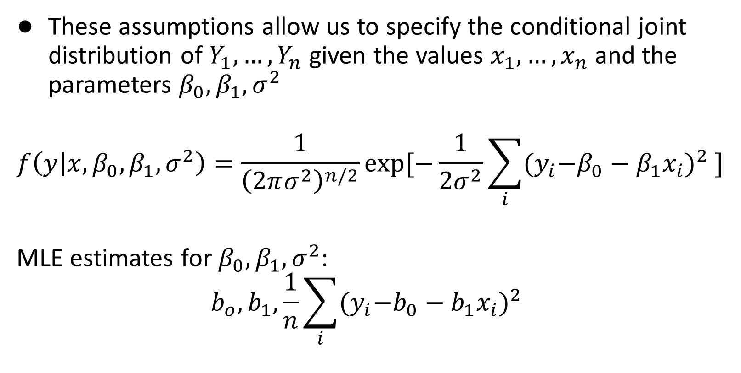
Why do we need these assumptions
These assumptions allow us to specify the conditional joint distribution of $Y_{1},…, Y_{n}$ given the values $x_{1},…, x_{n}$ and the parameters $β_{0},β_{1},σ^{2}$
$$f\left(y | x, β_{0},β_{1}, σ^{2}\right)=\frac{1}{{\left(2πσ^{2}\right)}^{n/2}}exp⁡[−\frac{1}{2σ^{2}}\sum_{i}{{{(y}_{i}−β_{0}−β_{1}x_{i})}^{2} ] }$$
MLE estimates for $β_{0},β_{1}, σ^{2}$:
$$b_{o}, b_{1}, \frac{1}{n}\sum_{i}{{{(y}_{i}−b_{0}−b_{1}x_{i})}^{2} }$$

Slide 65
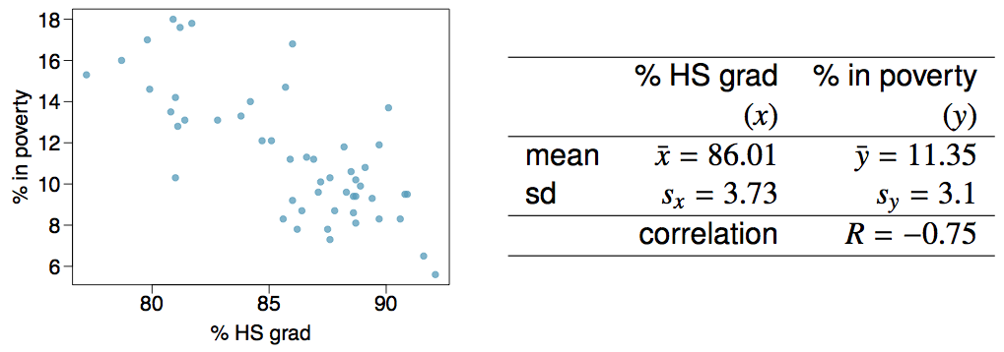
Given...

Slide 66

Slope
The slope of the regression can be calculated as

Slide 67

Slope
The slope of the regression can be calculated as
In context...

Slide 68
Slope
The slope of the regression can be calculated as
In context...
Interpretation
For each additional % point in HS graduate rate, we would expect the % living in poverty to be lower on average by 0.62% points.

Slide 69
Intercept
The intercept is where the regression line intersects the y-axis. The calculation of the intercept uses the fact the a regression line always passes through (x̄, ȳ).
b₀ = ȳ - b₁ x̄

Slide 70
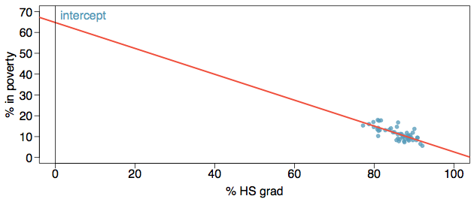
Intercept
The intercept is where the regression line intersects the y-axis. The calculation of the intercept uses the fact the a regression line always passes through (x̄, ȳ).
b₀ = ȳ - b₁ x̄

Slide 71
Intercept
The intercept is where the regression line intersects the y-axis. The regression line always passes through (x̄, ȳ).
b₀ = ȳ - b₁ x̄
b₀ = 11.35 - (-0.62) x 86.01
= 64.68

Slide 72
Which of the following is the correct interpretation of the intercept?
For each % point increase in HS graduate rate, % living in poverty is expected to increase on average by 64.68%.
For each % point decrease in HS graduate rate, % living in poverty is expected to increase on average by 64.68%.
Having no HS graduates leads to 64.68% of residents living below the poverty line.
States with no HS graduates are expected on average to have 64.68% of residents living below the poverty line.
In states with no HS graduates % living in poverty is expected to increase on average by 64.68%.

Slide 73
Which of the following is the correct interpretation of the intercept?
For each % point increase in HS graduate rate, % living in poverty is expected to increase on average by 64.68%.
For each % point decrease in HS graduate rate, % living in poverty is expected to increase on average by 64.68%.
Having no HS graduates leads to 64.68% of residents living below the poverty line.
States with no HS graduates are expected on average to have 64.68% of residents living below the poverty line.
In states with no HS graduates % living in poverty is expected to increase on average by 64.68%.

Slide 74
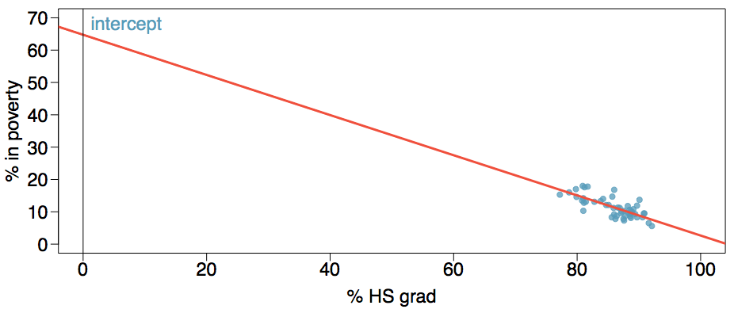
More on the intercept
Since there are no states in the dataset with no HS graduates, the intercept is of no interest, not very useful, and also not reliable since the predicted value of the intercept is so far from the bulk of the data.

Slide 75
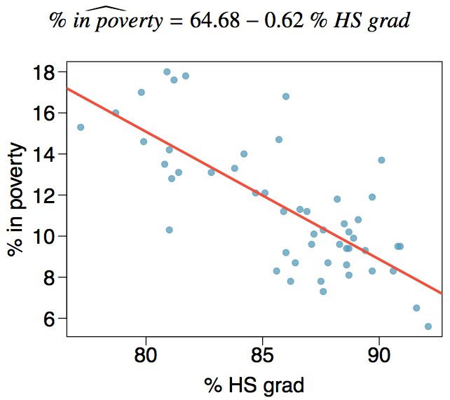
Regression line

Slide 76
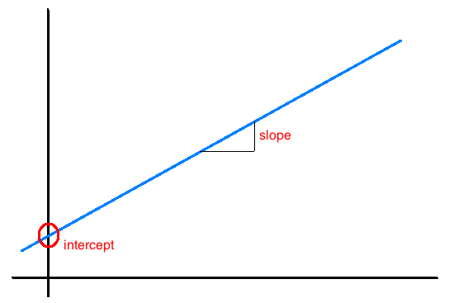
Interpretation of slope and intercept
Intercept: When x = 0, y is
expected to equal
the intercept.
Slope: For each unit in x, y is
expected to increase /
decrease on average
by the slope.

Slide 77
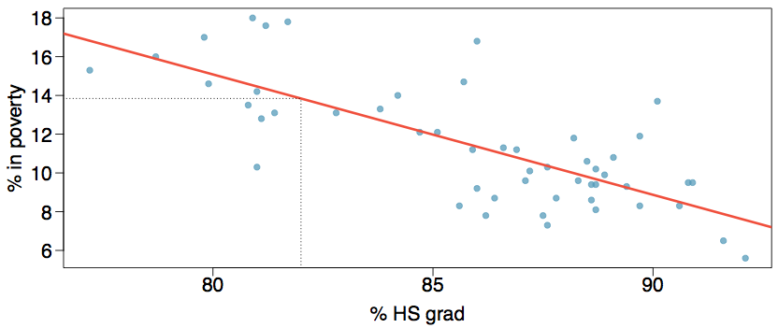
Prediction
Using the linear model to predict the value of the response variable for a given value of the explanatory variable is called prediction, simply by plugging in the value of x in the linear model equation.
There will be some uncertainty associated with the predicted value.

Slide 78
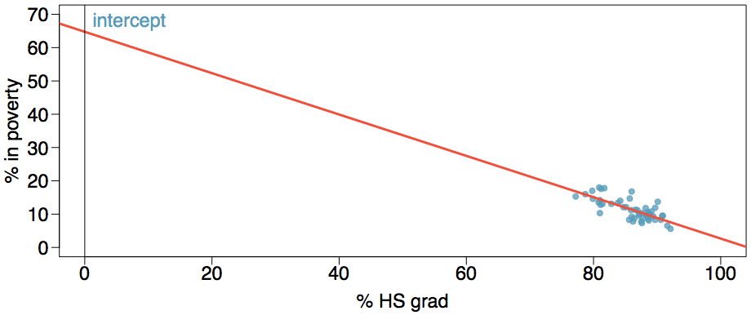
Extrapolation
Applying a model estimate to values outside of the realm of the original data is called extrapolation.
Sometimes the intercept might be an extrapolation.

Slide 79
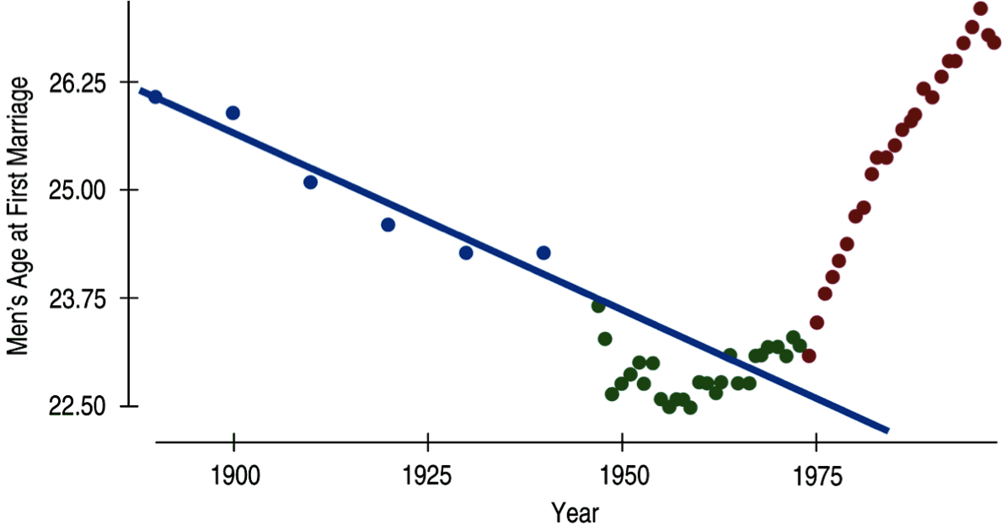
Examples of extrapolation

Slide 80
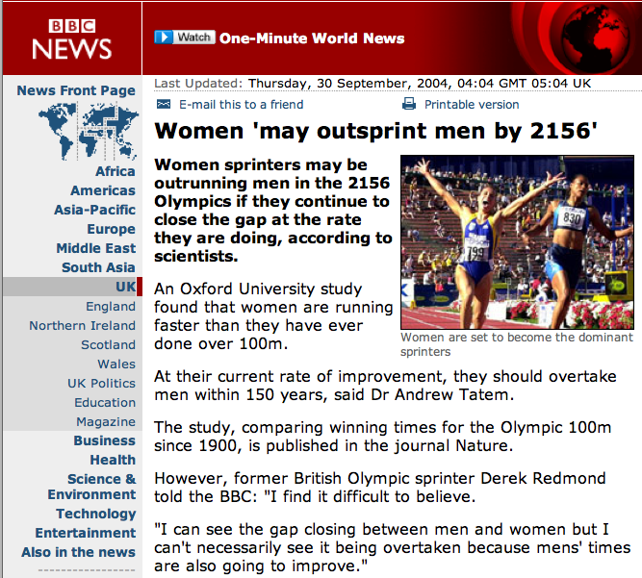
Examples of extrapolation

Slide 81
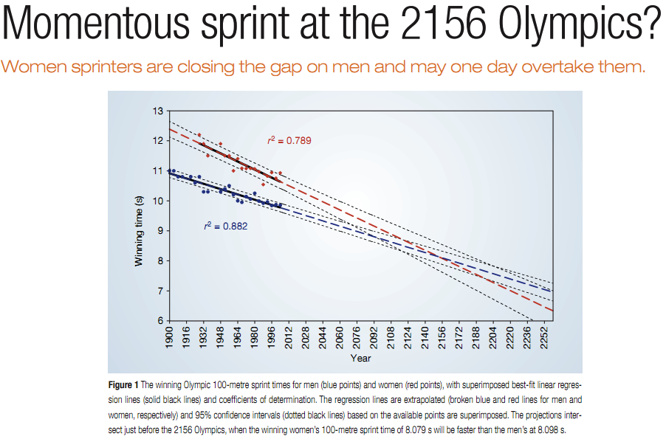
Examples of extrapolation

